Slide 1


Slide 2
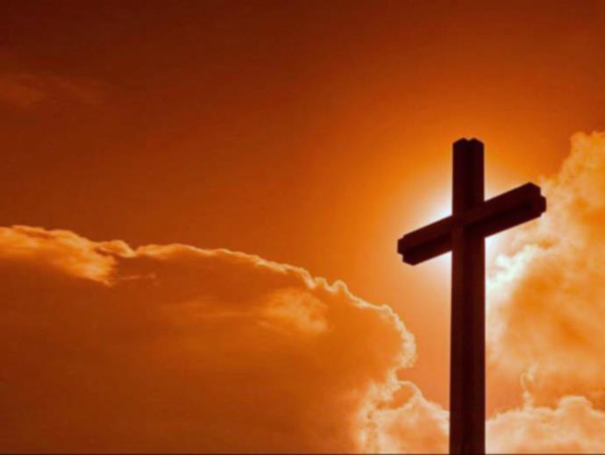
【传道书 Ecclesiastes 1:9】
已有的事，后必再有；已行的事，后必再行。日光之下，并无新事。
That which has been is what will be, That which is done is what will be done, And there is nothing new under the sun.

Slide 3
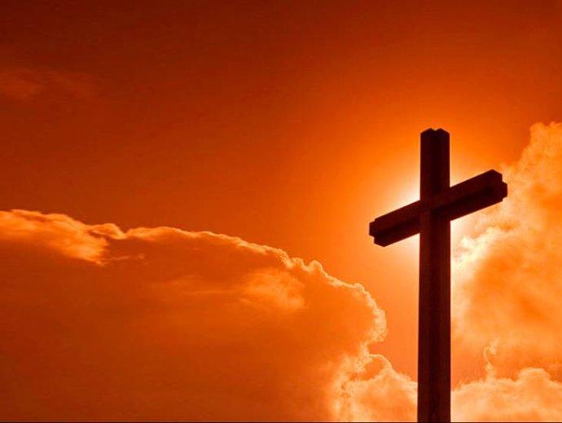
【启示录 Revelation 21:4-5】
4 神要擦去他们一切的眼泪，不再有死亡，也不再有悲哀、哭号、疼痛，因为以前的事都过去了。” And God will wipe away every tear from their eyes; there shall be no more death, nor sorrow, nor crying. There shall be no more pain, for the former things have passed away.”

Slide 4
【启示录 Revelation 21:4-5】
5 坐宝座的说：“看哪，我将一切都更新了。”又说：“你要写上，因这些话是可信的，是真实的。”
Then He who sat on the throne said, “Behold, I make all things new.” And He said to me, “Write, for these words are true and faithful.”

Slide 5
【创世记 Genesis 1:27】
神就照着自己的形象造人，乃是照着祂的形象造男造女。”
So God created man in His own image; in the image of God He created him; male and female He created them.

Slide 6
【诗篇 Psalms 14：2-3】
2 耶和华从天上垂看世人，要看有明白的没有，有寻求 神的没有。
The LORD looks down from heaven on the sons of men to see if there are any who understand, any who seek God.
3 他们都偏离正路，一同变为污秽；并没有行善的，连一个也没有。
All have turned aside, they have together become corrupt; there is no one who does good, not even one.

Slide 7
【罗马书 Romans 3:10】
就如经上所记：“没有义人，连一个也没有；
As it is written: “There is none righteous, no, not one;
【罗马书 Romans 3:23】
因为世人都犯了罪，亏缺了 神的荣耀，
for all have sinned and fall short of the glory of God,

Slide 8
【雅各书 James 1:15】
私欲既怀了胎，就生出罪来；罪既长成，就生出死来。
Then, when desire has conceived, it gives birth to sin; and sin, when it is full-grown, brings forth death.
【希伯来书 Hebrews 9:27】
按着定命，人人都有一死，死后且有审判。
And as it is appointed for men to die once, but after this the judgment,

Slide 9
【马太福音 Matthew 1:21】
她将要生一个儿子，你要给祂起名叫耶稣，因祂要将自己的百姓从罪恶里救出来。”
And she will bring forth a Son, and you shall call His name Jesus, for He will save His people from their sins.”

Slide 10
【罗马书 Romans 5:8】
惟有基督在我们还作罪人的时候为我们死， 神的爱就在此向我们显明了。
But God demonstrates his own love for us in this: While we were still sinners, Christ died for us.

Slide 11
【约翰福音 John 3:16】
16 “ 神爱世人，甚至将祂的独生子赐给他们，叫一切信祂的，不至灭亡，反得永生。
For God so loved the world that He gave His only begotten Son, that whoever believes in Him should not perish but have everlasting life.

Slide 12
【哥林多后书 2Corinthians 5:17】
若有人在基督里，他就是新造的人，旧事已过，都变成新的了。
Therefore, if anyone is in Christ, he is a new creation; the old has gone, the new has come!

Slide 13
【启示录 Revelation 21:3-5】
3 我听见有大声音从宝座出来说：“看哪， 神的帐幕在人间。祂要与人同住，他们要作祂的子民； 神要亲自与他们同在，作他们的 神。And I heard a loud voice from heaven saying, “Behold, the tabernacle of God is with men, and He will dwell with them, and they shall be His people. God Himself will be with them and be their God.

Slide 14
【启示录 Revelation 21:3-5】
4 神要擦去他们一切的眼泪，不再有死亡，也不再有悲哀、哭号、疼痛，因为以前的事都过去了。” And God will wipe away every tear from their eyes; there shall be no more death, nor sorrow, nor crying. There shall be no more pain, for the former things have passed away.”

Slide 15
【启示录 Revelation 21:3-5】
5 坐宝座的说：“看哪，我将一切都更新了。”又说：“你要写上，因这些话是可信的，是真实的。”
Then He who sat on the throne said, “Behold, I make all things new.” And He said to me, “Write, for these words are true and faithful.”

