Slide 1

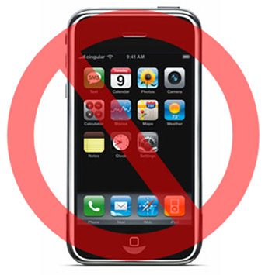
请在聚会之前,
将您的手机调至静音。谢谢！
Thank you for silencing your phone!

Slide 2
诗篇 Psalms 118:24
24. 這是耶和華所定的日子．
我們在其中要高興歡喜。
This is the day the LORD has made;
let us rejoice and be glad in it.

Slide 3
約翰福音 John 1:29
29. 次日, 約翰看見耶穌來到他那裡, 就說: “看哪, 神的羔羊, 除去世人罪孽的。”
The next day John saw Jesus coming toward him and said, "Look, the Lamb of God, who takes away the sin of the world!

Slide 4
彼得前書 1 Peter 2:24;
罗马书 Romans 5:6-8;
诗篇 Psalms 103:1-4
24. 他被掛在木頭上親身擔當了我們的罪、使我們既然在罪上死、就得以在義上活．因他受的鞭傷、你們便得了醫治。
He himself bore our sins in his body on the tree, so that we might die to sins and live for righteousness; by his wounds you have been healed.

Slide 5
6. 因我们还软弱的时候，基督就按所定的日期为罪人死。
7. 为义人死，是少有的，为仁人死，或者有敢作的。
6. You see, at just the right time, when we were still powerless, Christ died for the ungodly.
7. Very rarely will anyone die for a righteous person, though for a good person someone might possibly dare to die.

Slide 6
8. 惟有基督在我们还作罪人的时候为我们死，神的爱就在此向我们显明了。
8. But God demonstrates his own love for us in this: While we were still sinners, Christ died for us.

Slide 7
1. 我的心哪、你要稱頌耶和華．凡在我裡面的、也要稱頌他的聖名。
Praise the LORD, O my soul; all my inmost being, praise his holy name.
2.我的心哪、你要稱頌耶和華、不可忘記他的一切恩惠。
Praise the LORD, O my soul, and forget not all his benefits-

Slide 8
3. 他赦免你的一切罪孽、醫治你的一切疾病。
who forgives all your sins and heals all your diseases,
4. 他救贖你的命脫離死亡、以仁愛和慈悲為你的冠冕。
who redeems your life from the pit and crowns you with love and compassion,

Slide 9
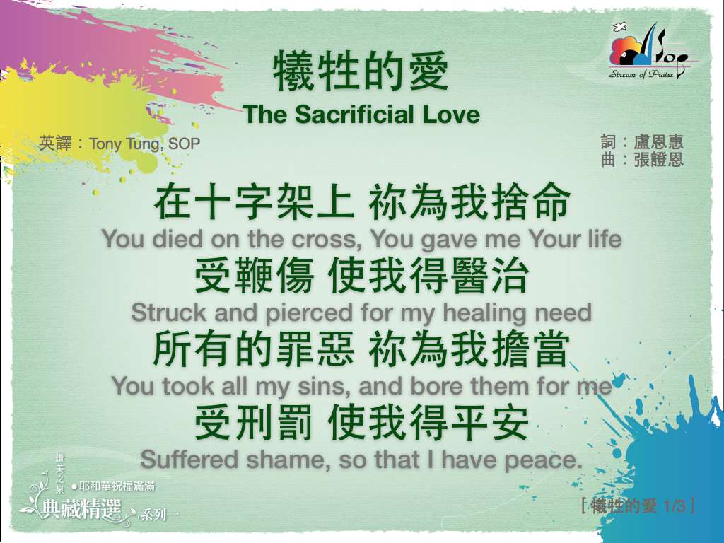

Slide 10
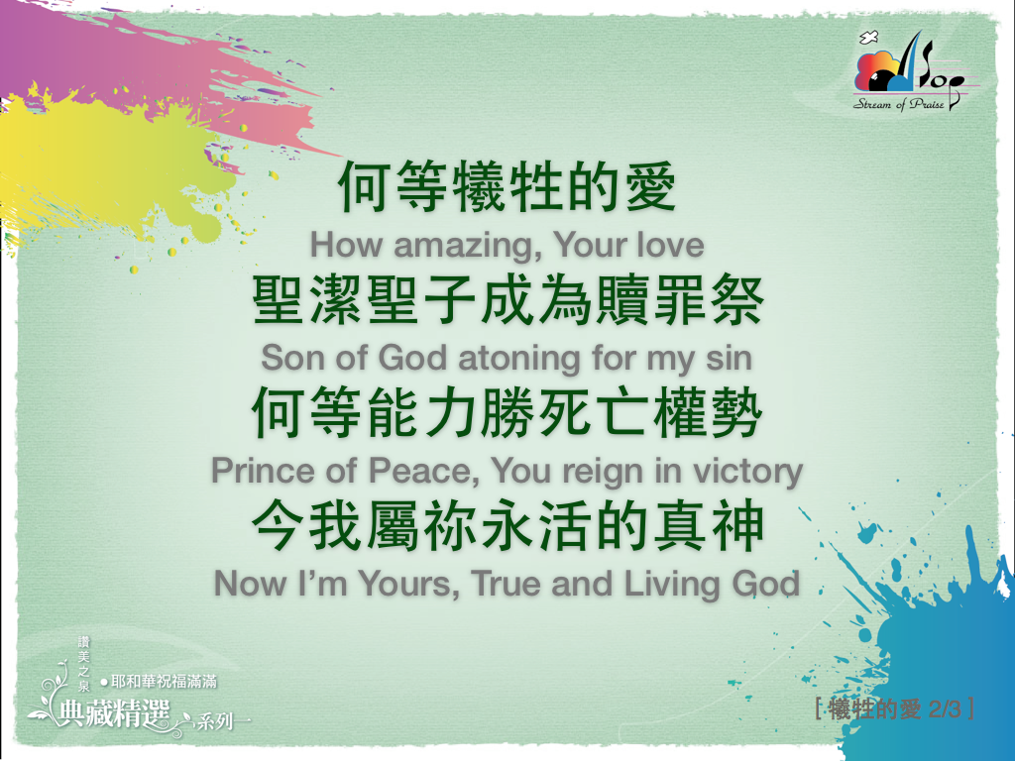

Slide 11


Slide 12
以赛亚书 Isaiah 53:1-10
1. 我们所传的, 有谁信呢？耶和华的膀臂向谁显露呢？
Who has believed our message and to whom has the arm of the LORD been revealed?
2. 他在耶和华面前生长如嫩芽，像根出于干地。他无佳形美容，我们看见他的时候，也无美貌使我们羡慕他。
He grew up before him like a tender shoot, and like a root out of dry ground. He had no beauty or majesty to attract us to him, nothing in his appearance that we should desire him.

Slide 13
3. 他被藐视, 被人厌弃, 多受痛苦, 常经忧患。他被藐视，好像被人掩面不看的一样。我们也不尊重他。
He was despised and rejected by men, a man of sorrows, and familiar with suffering. Like one from whom men hide their faces he was despised, and we esteemed him not.
4. 他诚然担当我们的忧患，背负我们的痛苦。我们却以为他受责罚，被神击打苦待了。
Surely he took up our infirmities and carried our sorrows, yet we considered him stricken by God, smitten by him, and afflicted.

Slide 14
5. 哪知他为我们的过犯受害，为我们的罪孽压伤。因他受的刑罚我们得平安。因他受的鞭伤我们得医治。
But he was pierced for our transgressions, he was crushed for our iniquities; the punishment that brought us peace was upon him, and by his wounds we are healed.
6. 我们都如羊走迷，各人偏行己路。耶和华使我们众人的罪孽都归在他身上。
We all, like sheep, have gone astray, each of us has turned to his own way; and the LORD has laid on him the iniquity of us all.

Slide 15
7. 他被欺压，在受苦的时候却不开口。他像羊羔被牵到宰杀之地，又像羊在剪毛的人手下无声，他也是这样不开口。
He was oppressed and afflicted, yet he did not open his mouth; he was led like a lamb to the slaughter, and as a sheep before her shearers is silent, so he did not open his mouth.
8. 因受欺压和审判他被夺去。至于他同世的人，谁想他受鞭打，从活人之地被剪除，是因我百姓的罪过呢？
By oppression and judgment he was taken away. And who can speak of his descendants? For he was cut off from the land of the living; for the transgression of my people he was stricken.

Slide 16
9. 他虽然未行强暴，口中也没有诡诈，人还使他与恶人同埋。谁知死的时候与财主同葬。
He was assigned a grave with the wicked, and with the rich in his death, though he had done no violence, nor was any deceit in his mouth.
10. 耶和华却定意将他压伤，使他受痛苦。耶和华以他为赎罪祭。他必看见后裔，并且延长年日，耶和华所喜悦的事，必在他手中亨通。
Yet it was the LORD's will to crush him and cause him to suffer, and though the LORD makes his life a guilt offering, he will see his offspring and prolong his days, and the will of the LORD will prosper in his hand.

Slide 17


Slide 18
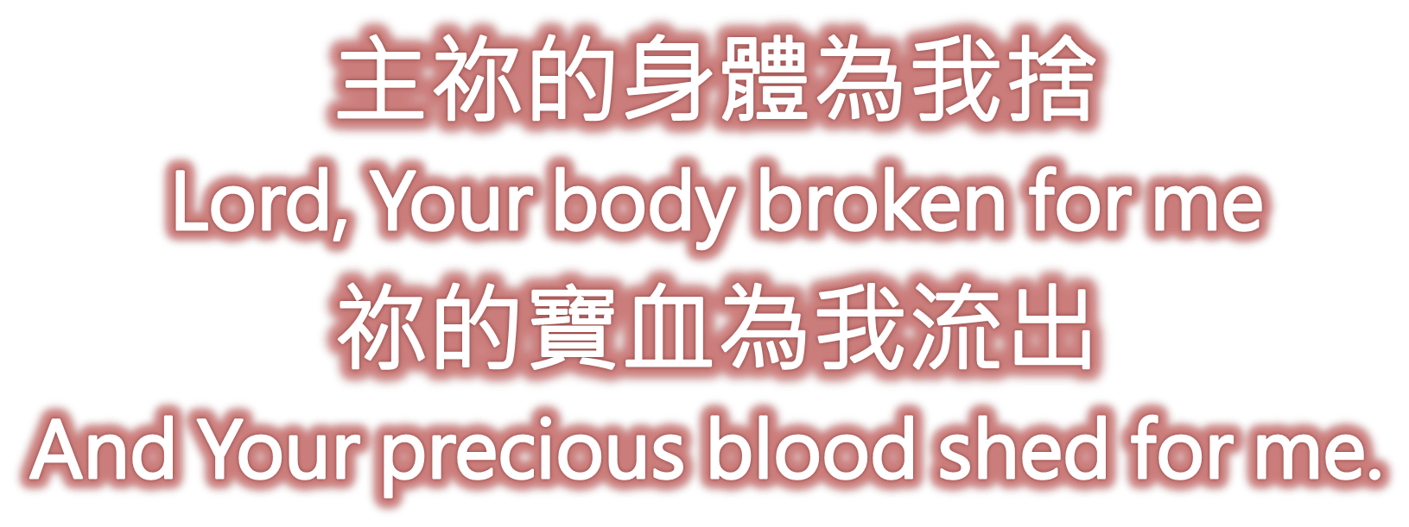

Slide 19
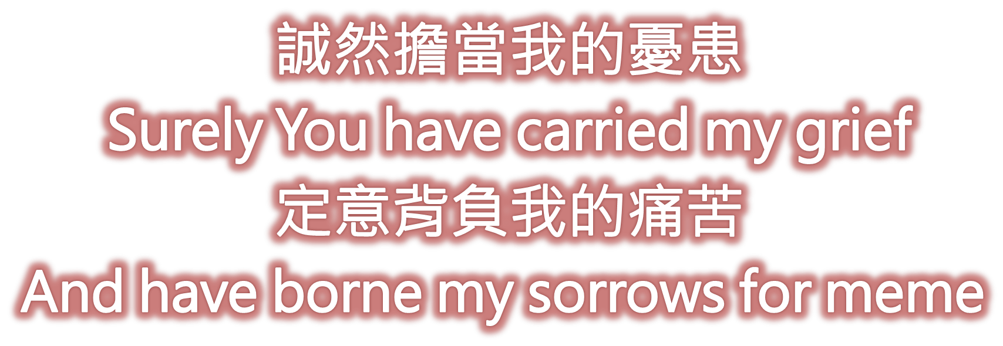

Slide 20
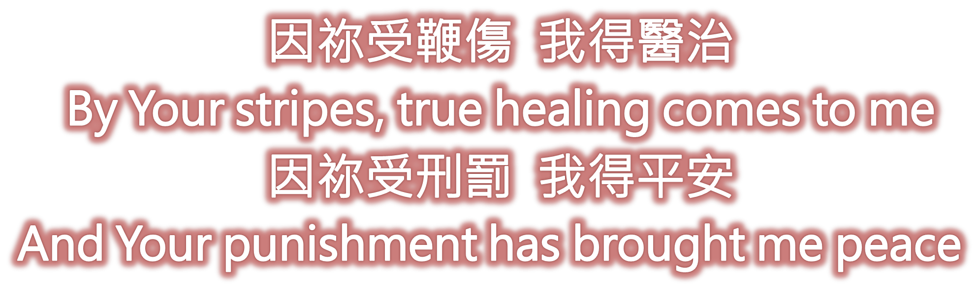

Slide 21
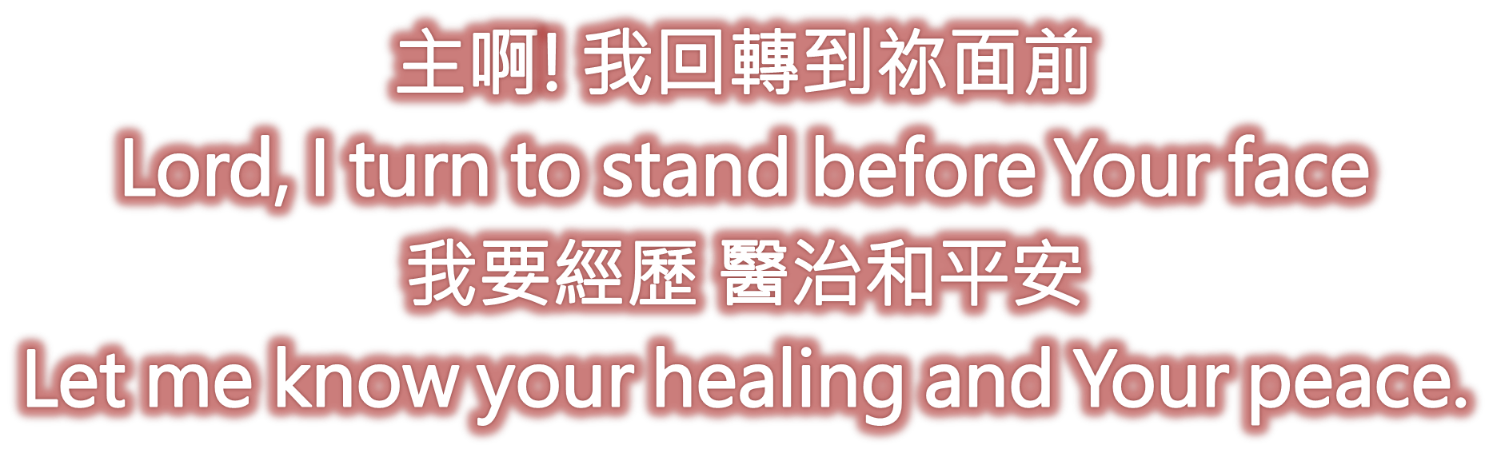

Slide 22
1. 我的心哪、你要稱頌耶和華．凡在我裡面的、也要稱頌他的聖名。
Praise the LORD, O my soul; all my inmost being, praise his holy name.
2.我的心哪、你要稱頌耶和華、不可忘記他的一切恩惠。
Praise the LORD, O my soul, and forget not all his benefits-

Slide 23
3. 他赦免你的一切罪孽、醫治你的一切疾病。
who forgives all your sins and heals all your diseases,
4. 他救贖你的命脫離死亡、以仁愛和慈悲為你的冠冕。
who redeems your life from the pit and crowns you with love and compassion,

Slide 24
9. 神差他獨生子到世間來、使我們藉著他得生、 神愛我們的心、在此就顯明了。
This is how God showed his love among us: He sent his one and only Son into the world that we might live through him.

Slide 25
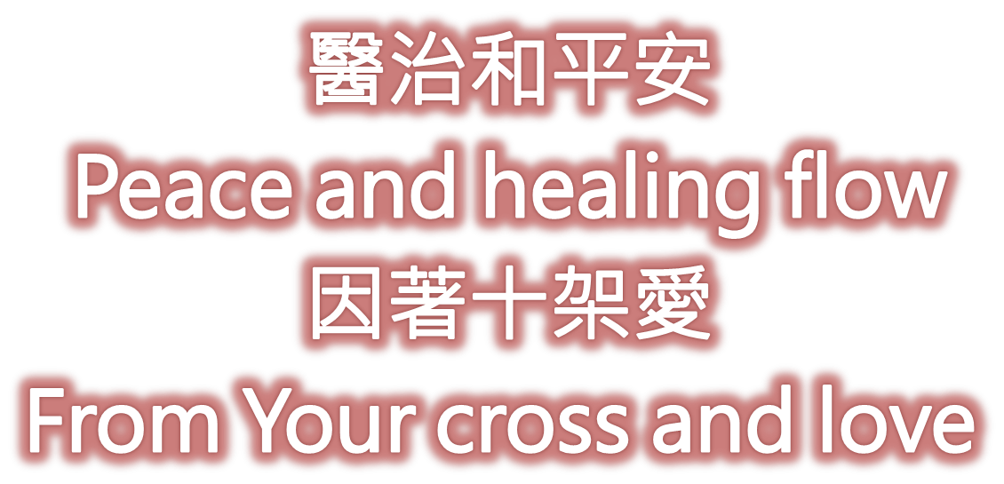

Slide 26
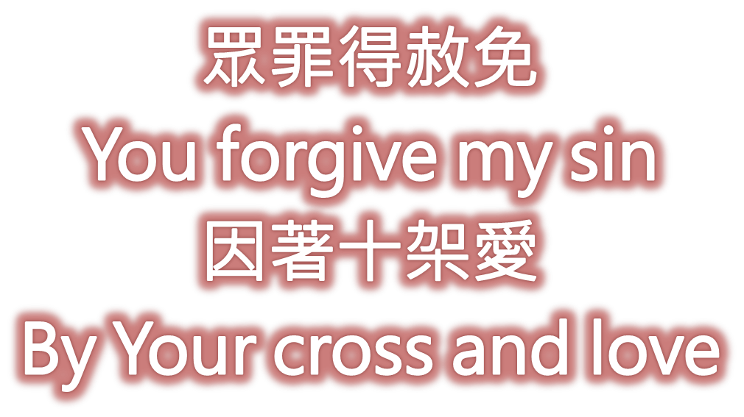

Slide 27
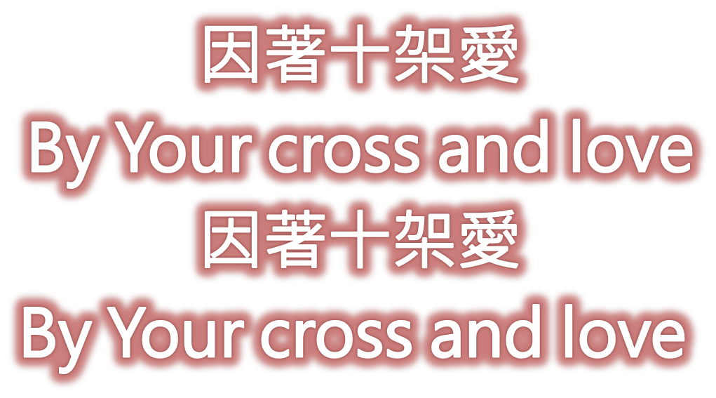

Slide 28
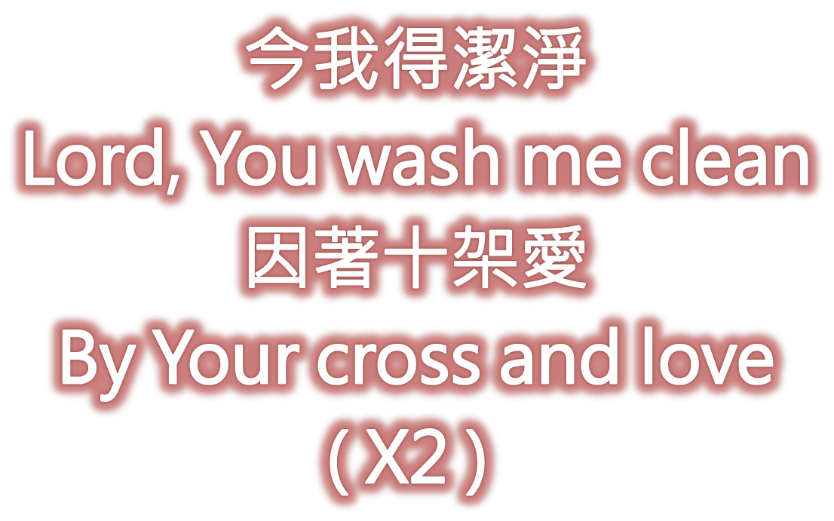

Slide 29
哥林多前书
1 Corinthians 15:55-57
55. 死啊、你得勝的權勢在那裡．死啊、你的毒鉤在那裡．
"Where, O death, is your victory? Where, O death, is your sting?"

Slide 30
56. 死的毒鉤就是罪．罪的權勢就是律法。
The sting of death is sin, and the power of sin is the law.
57. 感謝神、使我們藉著我們的主耶穌基督得勝。
But thanks be to God! He gives us the victory through our Lord Jesus Christ.

Slide 31
加拉太書 Galatians 6:14
14. 但我斷不以別的誇口、只誇我們主耶穌基督的十字架．因這十字架、就我而論、世界已經釘在十字架上．就世界而論、我已經釘在十字架上。
May I never boast except in the cross of our Lord Jesus Christ, through which the world has been crucified to me, and I to the world.

Slide 32
古舊十架
The Old Rugged Cross

Slide 33
各各他山嶺上 矗立古舊十架
是羞辱與痛苦記號
神愛子主耶穌
為我們被釘死
這十架是我 最愛最寶
On a hill far away stood an old rugged cross
The emblem of suffering and shame
And I love that old cross where the dearest and best
For a world of lost sinners was slain
1/4

Slide 34
*
故我愛高舉主十字架
願將世上虛榮全放下
我一生要背負十字架
到那天可換公義冠冕
So I’ll cherish the old rugged cross
Till my trophies at last I lay down
I will cling to the old rugged cross
And exchange it some day for a crown

Slide 35
這古舊十字架 被世人所輕視
我卻以十架為寶貴
神愛子主耶穌
捨棄天堂榮華
願背負十架 往各各他
On that old rugged cross so despised by the world
Has a wondrous attraction for me
For the dear Lamb of God left His glory above
To bear it to dark Calvary
2/4

Slide 36
*
故我愛高舉主十字架
願將世上虛榮全放下
我一生要背負十字架
到那天可換公義冠冕
So I’ll cherish the old rugged cross
Till my trophies at last I lay down
I will cling to the old rugged cross
And exchange it some day for a crown

Slide 37
各各他十字架 雖有血跡斑斑
我看它仍聖潔華美
因救主在十架
為我罪被釘死
我罪惡全赦免得稱義
In the old rugged cross stained with blood so divine
A wondrous beauty I see
For it was on that old cross Jesus suffered and died
To pardon and sanctify me
3/4

Slide 38
*
故我愛高舉主十字架
願將世上虛榮全放下
我一生要背負十字架
到那天可換公義冠冕
So I’ll cherish the old rugged cross
Till my trophies at last I lay down
I will cling to the old rugged cross
And exchange it some day for a crown

Slide 39
對這古舊十架 我願永遠忠誠
甘受世人辱罵恥笑
救主快要再來
迎接我到天家
與救主共享 永遠榮耀
To the old rugged cross I will ever be true
Its shame and reproach gladly bear
Then He’ll call me some day to my home far away
Where His glory forever I’ll share
4/4

Slide 40
*
故我愛高舉主十字架
願將世上虛榮全放下
我一生要背負十字架
到那天可換公義冠冕
So I’ll cherish the old rugged cross
Till my trophies at last I lay down
I will cling to the old rugged cross
And exchange it some day for a crown

Slide 41
十字架，十字架，
永是我的榮耀，
我眾罪都洗清潔，
惟靠耶穌寶血。
In the cross, in the cross,
Be my glory ever;
All my sins are cleansed away,
Through the blood of Christ alone.

Slide 42
十字架，十字架，
永是我的榮耀，
我眾罪都洗清潔，
惟靠耶穌寶血。
In the cross, in the cross,
Be my glory ever;
All my sins are cleansed away,
Through the blood of Christ alone.

Slide 43
十字架，十字架，
永遠是我榮耀;
直到我歡聚天家，
仍誇主十字架。
In the cross, in the cross,
Be my glory ever;
Till my raptured soul shall find Rest beyond the river.

