Slide 1
得救与好行为
以弗所书 2:8-10
2015-11-22

Slide 2
以弗所书 2 1:3
你们死在过犯罪恶之中，他叫你们活过来。 ² 那时你们在其中行事为人，随从今世的风俗，顺服空中掌权者的首领，就是现今在悖逆之子心中运行的邪灵。 ³ 我们从前也都在他们中间，放纵肉体的私欲，随着肉体和心中所喜好的去行，本为可怒之子，和别人一样。
Ephesians 2 1:3
As for you, you were dead in your transgressions and sins, ² in which you used to live when you followed the ways of this world and of the ruler of the kingdom of the air, the spirit who is now at work in those who are disobedient.³ All of us also lived among them at one time, gratifying the cravings of our flesh and following its desires and thoughts. Like the rest, we were by nature deserving of wrath.

Slide 3
以弗所书 2 4-7
⁴ 然而，神既有丰富的怜悯，因他爱我们的大爱， ⁵ 当我们死在过犯中的时候，便叫我们与基督一同活过来。你们得救是本乎恩。 ⁶ 他又叫我们与基督耶稣一同复活，一同坐在天上， ⁷ 要将他极丰富的恩典，就是他在基督耶稣里向我们所施的恩慈，显明给后来的世代看。
Ephesians 2:4-7
⁴ But because of his great love for us, God, who is rich in mercy, ⁵ made us alive with Christ even when we were dead in transgressions—it is by grace you have been saved. ⁶ And God raised us up with Christ and seated us with him in the heavenly realms in Christ Jesus, ⁷ in order that in the coming ages he might show the incomparable riches of his grace, expressed in his kindness to us in Christ Jesus.

Slide 4
以弗所书 2 8:10
⁸ 你们得救是本乎恩，也因着信。这并不是出于自己，乃是神所赐的； ⁹ 也不是出于行为，免得有人自夸。 ¹⁰ 我们原是他的工作，在基督耶稣里造成的，为要叫我们行善，就是神所预备叫我们行的。
Ephesians 2 8:10
⁸ For it is by grace you have been saved, through faith—and this is not from yourselves, it is the gift of God— ⁹ not by works, so that no one can boast. ¹⁰ For we are God’s handiwork, created in Christ Jesus to do good works, which God prepared in advance for us to do.

Slide 5
蒙恩得救
我们的本相：活在撒旦掌控中，放纵私欲，不认识上帝,死在罪中 (以2:1-3, Eph 2:1-3)
神爱我们，基督耶稣道成肉生，在十字架上为我们的罪献了赎罪祭; 我们得救赎，与基督一同复活， 得丰盛的生命 (以2:4-7, Eph 2:4-7)
救恩是神的恩典，是神所赐的，不是靠自己，不是靠好行为。(以2:8, Eph 2:8)

Slide 6
雅各书 2:14-17
我的弟兄们，若有人说自己有信心，却没有行为，有什么益处呢？这信心能救他吗？¹⁵ 若是弟兄或是姐妹赤身露体，又缺了日用的饮食， ¹⁶ 你们中间有人对他们说“平平安安地去吧，愿你们穿得暖、吃得饱”，却不给他们身体所需用的，这有什么益处呢？ ¹⁷ 这样，信心若没有行为就是死的。
James 2:14-17
¹⁴ What good is it, my brothers and sisters, if someone claims to have faith but has no deeds? Can such faith save them? ¹⁵ Suppose a brother or a sister is without clothes and daily food. ¹⁶ If one of you says to them, “Go in peace; keep warm and well fed,” but does nothing about their physical needs, what good is it? ¹⁷ In the same way, faith by itself, if it is not accompanied by action, is dead.

Slide 7
以弗所书 2 1:10
¹⁰ 我们原是他的工作，在基督耶稣里造成的，为要叫我们行善，就是神所预备叫我们行的。
Ephesians 2 1:10
¹⁰ For we are God’s handiwork, created in Christ Jesus to do good works, which God prepared in advance for us to do.
以弗所 2:10: 完美的把得救与好行为(行善)联结起来

Slide 8
好行为
好行为不能使人得救.
然而，好行为是蒙恩得救的人的更新生命的外在表现.
好行为是信心所结的果子.
好行为是圣灵在我们里面的工作，是神为我们预备的。
所以，“信心”若没有好行为就不是真正的信心。
约翰福音 15:5 John 15:5
我是葡萄树，你们是枝子。常在我里面的，我也常在他里面，这人就多结果子；因为离了我，你们就不能做什么。
⁵ “I am the vine; you are the branches. If you remain in me and I in you, you will bear much fruit; apart from me you can do nothing.

Slide 9
神为我们预备的完美计划
蒙恩得救赎，进入天国的门，成为上帝的儿女.
成为神在基督里造成的至贵的艺术品，有用的器皿，为神服事，行善，有好行为。
得奖赏。得着神为我们预备的极其丰富的冠冕和奖赏，成为神的荣耀，与主基督耶稣同享荣耀。
荣耀! 荣耀! 荣耀!

Slide 10
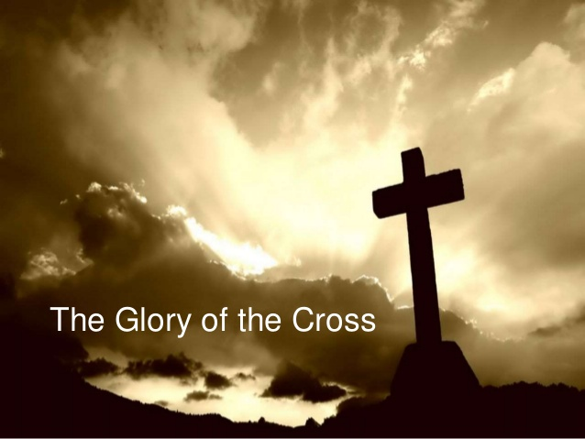
“十字架是我的荣耀,我蒙救赎恩典的记号“
十字架是上帝彰显祂 公义, 怜悯, 慈爱,
恩典, 智慧, 和大能的荣耀

Slide 11
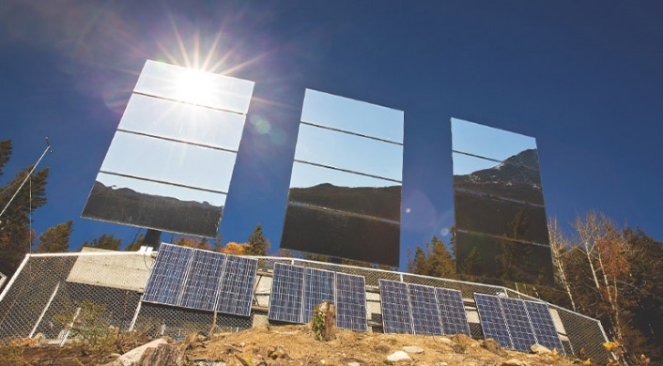
你们是世上的光。城造在山上，是不能隐藏的。 ¹⁶ 你们的光也当这样照在人前，叫他们看见你们的好行为，便将荣耀归给你们在天上的父。---马太副音5:14-16
You are the light of the world. A town built on a hill cannot be hidden….let your light shine before others, that they may see your good deeds and glorify your Father in heaven. --- Matthew 5:14-16

Slide 12
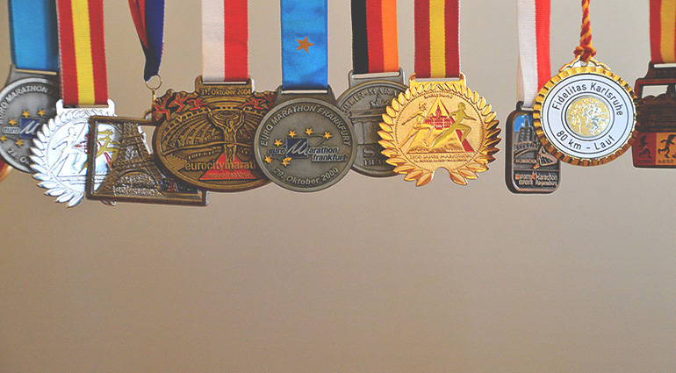
腓立比书 3:14 Philippians 3:14
向着标竿直跑，要得神在基督耶稣里从上面召我来得的奖赏。
I press on toward the goal to win the prize for which God has called me heavenward in Christ Jesus.

Slide 13
提摩太后书 4:6-8 2 Timothy 4:6-8
⁷ 那美好的仗我已经打过了，当跑的路我已经跑尽了，所信的道我已经守住了。 ⁸ 从此以后，有公义的冠冕为我存留，就是按着公义审判的主到了那日要赐给我的；不但赐给我，也赐给凡爱慕他显现的人。
For I am already being poured out like a drink offering, and the time for my departure is near. ⁷ I have fought the good fight, I have finished the race, I have kept the faith. ⁸ Now there is in store for me the crown of righteousness, which the Lord, the righteous Judge, will award to me on that day—and not only to me, but also to all who have longed for his appearing.

Slide 14
行善(good work), 好行为(good deed) 的例子
顺服的好行为。
但以理 6: 10,13-14,16,19-22,26
Daniel 6: 10, 13-14, 16, 19-22, 26
17 岁被掳,但以理立志不沾污自己,以温柔智慧取胜
但以理顺服神，不与世界妥协，坚持一天三次祷告, 连敌人的君王都敬畏他的神，赞美他的神．

Slide 15
但以理 6: 10 Daniel 6:10
但以理知道这禁令盖了玉玺，就到自己家里（他楼上的窗户开向耶路撒冷），一日三次双膝跪在他神面前祷告感谢，与素常一样。
Now when Daniel learned that the decree had been published, he went home to his upstairs room where the windows opened toward Jerusalem. Three times a day he got down on his knees and prayed, giving thanks to his God, just as he had done before.

Slide 16
但以理 6: 13-14 Daniel 6:13-14
他们对王说：“王啊，那被掳之犹大人中的但以理不理你，也不遵你盖了玉玺的禁令，他竟一日三次祈祷。” ¹⁴ 王听见这话就甚愁烦，一心要救但以理，筹划解救他，直到日落的时候。
Then they said to the king, “Daniel, who is one of the exiles from Judah, pays no attention to you, Your Majesty, or to the decree you put in writing. He still prays three times a day.” ¹⁴ When the king heard this, he was greatly distressed; he was determined to rescue Daniel and made every effort until sundown to save him.

Slide 17
但以理 6: 16 Daniel 6:16
¹⁶ 王下令，人就把但以理带来，扔在狮子坑中。王对但以理说：“你所常侍奉的神，他必救你。
¹⁶ So the king gave the order, and they brought Daniel and threw him into the lions’ den. The king said to Daniel, “May your God, whom you serve continually, rescue you!”

Slide 18
但以理 6: 19-22 Daniel 6:19-22
¹⁹ 次日黎明王就起来，急忙往狮子坑那里去。 ²⁰ 临近坑边，哀声呼叫但以理，对但以理说：“永生神的仆人但以理啊，你所常侍奉的神能救你脱离狮子吗？” ²¹ 但以理对王说：“愿王万岁！ ²² 我的神差遣使者封住狮子的口，叫狮子不伤我，因我在神面前无辜，我在王面前也没有行过亏损的事。
¹⁹ At the first light of dawn, the king got up and hurried to the lions’ den.²⁰ When he came near the den, he called to Daniel in an anguished voice, “Daniel, servant of the living God, has your God, whom you serve continually, been able to rescue you from the lions?”
²¹ Daniel answered, “May the king live forever! ²² My God sent his angel, and he shut the mouths of the lions. They have not hurt me, because I was found innocent in his sight. Nor have I ever done any wrong before you, Your Majesty.”

Slide 19
但以理 6: 26 Daniel 6:26
²⁶ 现在我降旨晓谕我所统辖的全国人民，要在但以理的神面前战兢恐惧。因为他是永远长存的活神，他的国永不败坏，他的权柄永存无极。 ²⁷ 他护庇人，搭救人，在天上地下施行神迹奇事，救了但以理脱离狮子的口。”
²⁶ “I issue a decree that in every part of my kingdom people must fear and reverence the God of Daniel.
“For he is the living God
and he endures forever;
his kingdom will not be destroyed,
his dominion will never end.
²⁷ He rescues and he saves;
he performs signs and wonders
in the heavens and on the earth.
He has rescued Daniel
from the power of the lions.”

Slide 20
但以理顺服神的好行为，连君王都称赞他
神的荣耀在但以理身上彰显, 君王都在祂面前战兢，承认神是活的，权柄永存无极。
人的心一旦顺服，神的救赎就必然产生力量。我若顺服基督，神的救赎就会透过我涌流到别人的生命上，因为在顺服的行动背後，是全能神真实的体现 －－章伯斯
When God’s redemption brings a human soul to the point of obedience, it always produces. If I obey Jesus Christ, the redemption of God will flow through me to the lives of others, because behind the deed of obedience is the reality of Almighty God． --- Oswald Chamber

Slide 21
行善(good work), 好行为(good deed) 的例子
爱主好行为。
耶稣被膏
马可福音 14
过两天是逾越节，又是除酵节，祭司长和文士想法子怎么用诡计捉拿耶稣杀他。 ² 只是说：“当节的日子不可，恐怕百姓生乱。”
Mark 14
14 Now the Passover and the Festival of Unleavened Bread were only two days away, and the chief priests and the teachers of the law were scheming to arrest Jesus secretly and kill him. ² “But not during the festival,” they said, “or the people may riot.”

Slide 22
³ 耶稣在伯大尼长大麻风的西门家里坐席的时候，有一个女人拿着一玉瓶至贵的真哪哒香膏来，打破玉瓶，把膏浇在耶稣的头上。 ⁴ 有几个人心中很不喜悦，说：“何用这样枉费香膏呢？ ⁵ 这香膏可以卖三十多两银子周济穷人。”他们就向那女人生气。
³ While he was in Bethany, reclining at the table in the home of Simon the Leper, a woman came with an alabaster jar of very expensive perfume, made of pure nard. She broke the jar and poured the perfume on his head.
⁴ Some of those present were saying indignantly to one another, “Why this waste of perfume? ⁵ It could have been sold for more than a year’s wages^{[a]}and the money given to the poor.” And they rebuked her harshly.

Slide 23
⁶ 耶稣说：“由她吧！为什么难为她呢？她在我身上做的是一件美事。 ⁷ 因为常有穷人和你们同在，要向他们行善随时都可以，只是你们不常有我。 ⁸ 她所做的是尽她所能的，她是为我安葬的事，把香膏预先浇在我身上。 ⁹ 我实在告诉你们：普天之下，无论在什么地方传这福音，也要述说这女人所做的，以为纪念。”
⁶ “Leave her alone,” said Jesus. “Why are you bothering her? She has done a beautiful thing to me. ⁷ The poor you will always have with you, and you can help them any time you want. But you will not always have me. ⁸ She did what she could. She poured perfume on my body beforehand to prepare for my burial. ⁹ Truly I tell you, wherever the gospel is preached throughout the world, what she has done will also be told, in memory of her.”

Slide 24
伯大尼的马利亚体贴神的心.
她爱主的好行为被主称赞,被世人纪念.
好行为的外在表现,是我们内在
对主真诚的爱,与主生命有连结
消灭自我
降服于基督

Slide 25
行善(good work), 好行为(good deed) 的教导
彼得前书 3:8-12 I Peter 3:8-12
⁸ 总而言之，你们都要同心，彼此体恤，相爱如弟兄，存慈怜谦卑的心。 ⁹ 不以恶报恶、以辱骂还辱骂，倒要祝福，因你们是为此蒙召，好叫你们承受福气。
⁸ Finally, all of you, be like-minded, be sympathetic, love one another, be compassionate and humble. ⁹ Do not repay evil with evil or insult with insult. On the contrary, repay evil with blessing, because to this you were called so that you may inherit a blessing.

Slide 26
行善(good work), 好行为(good deed) 的教导
彼得前书 3:8-12 I Peter 3:8-12
¹⁰ 因为经上说：“人若爱生命，愿享美福，须要禁止舌头不出恶言，嘴唇不说诡诈的话；
¹⁰ For,
“Whoever would love life
and see good days
must keep their tongue from evil
and their lips from deceitful speech.

Slide 27
行善(good work), 好行为(good deed) 的教导
彼得前书 3:8-12 I Peter 3:8-12
¹¹ 也要离恶行善，寻求和睦，一心追赶。为义受苦是有福的
¹² 因为主的眼看顾义人，主的耳听他们的祈祷；唯有行恶的人，主向他们变脸。
¹¹ They must turn from evil and do good;
they must seek peace and pursue it.
¹² For the eyes of the Lord are on the righteous
and his ears are attentive to their prayer,
but the face of the Lord is against those who do evil.”

Slide 28
行善(good work), 好行为(good deed) 的教导
彼得前书 3:8-12 I Peter 3:8-12
爱弟兄的好行为。
不出恶言，不说诡诈的话，
总要说赞美主的话，祝福别人的话，鼓励别人的话
总要常常喜乐,不住祷告,凡事谢恩,是神在基督里所定的旨意 (帖撒罗尼迦前书 5:14, I Th 5:14)
Rejoice always, ¹⁷ pray continually, ¹⁸ give thanks in all circumstances; for this is God’s will for you in Christ Jesus.
圣灵所结的果子，就是仁爱、喜乐、和平、忍耐、恩慈、良善、信实、 温柔、节制(加拉太书 5:22, Galatians 5:22)
The fruit of the Spirit is love, joy, peace, forbearance, kindness, goodness, faithfulness, ²³ gentleness and self-control.

Slide 29
好行为是把每一息的生命都与耶稣基督联合，认同。
Good deed: Every ounce of my being is identified with Jesus Christ
好行为是荣耀神，是神把我们在基督里塑造得更像祂儿子。
Good deed is for the glory of God; For we are made to be Christ like
Eph 2:10 in KJV:
For we are his workmanship, created in Christ Jesus unto good works, which God hath before ordained that we should walk in them.
Go, walk in them! 起来，行动.

Slide 30
启示录3
耶稣说, “我知道你的行为…. ²¹ 得胜的，我要赐他在我宝座上与我同坐，就如我得了胜，在我父的宝座上与他同坐一般。”
Jesus said, “I know your deeds…. ²¹ To the one who is victorious, I will give the right to sit with me on my throne, just as I was victorious and sat down with my Father on his throne.”
祷告:
荣耀尊贵的主,
谢谢十字架的救恩! 让我们用好行为来给世人看,杖着十字
架誇胜, 荣耀主, 等候与主基督耶稣同享荣耀！阿们！

