Slide 1
家 Family

Slide 2
詩 篇 Psalm 127:1
若不是耶和華建造房屋，建造的人就枉然勞力；若不是耶和華看守城池，看守的人就枉然警醒。
Unless the Lord builds the house,
the builders labor in vain.
Unless the Lord watches over the city,
the guards stand watch in vain.

Slide 3

什麼最重要?

Slide 4
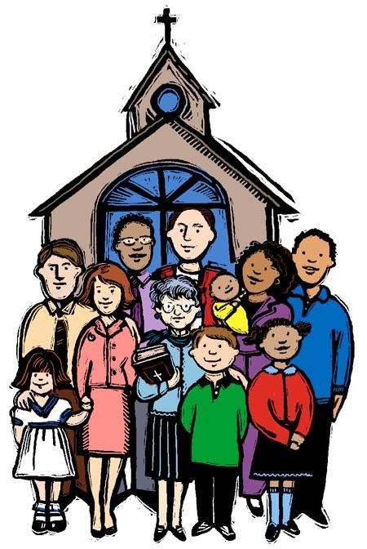


Slide 5
威斯敏斯德小要理問答
(The Westminster Shorter Catechism)
問：1. 人生的首要目的是什麽？
答：人生的首要目的就是榮耀上帝（1）， 並以他爲樂，直到永遠 （2）。
Q. 1. What is the chief end of man?
A. Man's chief end is to glorify God, and to enjoy him forever.

Slide 6
歌林多前書 1 Corinthians 10:31
所以，你們或吃或喝，無論做甚麼，
都要為榮耀神而行。
So, whether you eat or drink, or whatever you do, do all to the glory of God.

Slide 7
提摩太前書 1 Timothy 3:15
倘若我耽延日久，你也可以知道在神的家中當怎樣行。這家就是永生神的教會，真理的柱石和根基。
if I am delayed, you will know how people ought to conduct themselves in God’s household, which is the church of the living God, the pillar and foundation of the truth.

Slide 9
詩 篇 Psalm 127:1
若不是耶和華建造房屋，建造的人就枉然勞力；若不是耶和華看守城池，看守的人就枉然警醒。
Unless the Lord builds the house,
the builders labor in vain.
Unless the Lord watches over the city,
the guards stand watch in vain.

Slide 10
Fellowship & Worship 團契、敬拜
Available & Accountable 願意的心
Madidate God’s Word 思想 神的話
Intercession 代禱、禱告
Love 愛
Yield - Submit Yourself 順服的心

Slide 11
Fellowship & Worship 團契、敬拜
出埃及記 Exodus 8:1
耶和華吩咐摩西說：你進去見法老，對他說：耶和華這樣說：容我的百姓去，好事奉我。
Then the Lord said to Moses, “Go to Pharaoh and say to him, ‘This is what the Lord says: Let my people go, so that they may worship me.

Slide 12
Fellowship & Worship 團契、敬拜
希 伯 來 書 Hebrews 10:25
你們不可停止聚會，好像那些停止慣了的人，倒要彼此勸勉，既知道（原文是看見）那日子臨近，就更當如此。
not giving up meeting together, as some are in the habit of doing, but encouraging one another—and all the more as you see the Day approaching.

Slide 13
Available & Accountable 願意的心
我們是否注意到這幾週誰沒來聚會?
我們有多少次向新來的人問個好?

Slide 14
Available & Accountable 願意的心
我們是否注意到這幾週誰沒來聚會?
我們有多少次向新來的人問個好?
腓立比書 Philippians 2:4
各人不要單顧自己的事，也要顧別人的事。
not looking to your own interests but each of you to the interests of the others.

Slide 15
Available & Accountable 願意的心
Coming together is a beginning;
(約翰福音 John 10:16)
keeping together is progress;
(以弗所書 Ephesians 4:16)
working together is success in Christ.
(腓立比書 Philippians 1:27)

Slide 16
Madidate God’s Word 思想 神的話
詩篇 Psalm 1:1-2
不從惡人的計謀，不站罪人的道路，不坐褻慢人的座位，惟喜愛耶和華的律法，晝夜思想，這人便為有福！
Blessed is the one who does not walk in step with the wicked
or stand in the way that sinners take or sit in the company of mockers, but whose delight is in the law of the Lord, and who meditates on his law day and night.

Slide 17
Madidate God’s Word 思想 神的話
詩篇 Psalm 119:97
我何等愛慕你的律法，終日不住地思想。
Oh, how I love your law!
I meditate on it all day long.

Slide 18
Madidate God’s Word 思想 神的話
詩篇 Psalm 119:105
你的話是我腳前的燈，是我路上的光。
Your word is a lamp for my feet,
a light on my path.

Slide 19
Madidate God’s Word 思想 神的話
約 書 亞 記 Joshua 1:8
這律法書不可離開你的口，總要晝夜思想，好使你謹守遵行這書上所寫的一切話。如此，你的道路就可以亨通，凡事順利。
Keep this Book of the Law always on your lips; meditate on it day and night, so that you may be careful to do everything written in it. Then you will be prosperous and successful.

Slide 20
Madidate God’s Word 思想 神的話
約 書 亞 記 Joshua 1:8
這律法書不可離開你的口，總要晝夜思想，好使你謹守遵行這書上所寫的一切話。如此，你的道路就可以亨通，凡事順利。
Keep this Book of the Law always on your lips; meditate on it day and night, so that you may be careful to do everything written in it. Then you will be prosperous and successful.
How many verses in Bible?

Slide 21
Madidate God’s Word 思想 神的話
約 書 亞 記 Joshua 1:8
這律法書不可離開你的口，總要晝夜思想，好使你謹守遵行這書上所寫的一切話。如此，你的道路就可以亨通，凡事順利。
Keep this Book of the Law always on your lips; meditate on it day and night, so that you may be careful to do everything written in it. Then you will be prosperous and successful.
There are 23,145 verses in the Old Testament and 7,957 verses in the New Testament.
This gives a total of 31,102 verses

Slide 22
Madidate God’s Word 思想 神的話
約 書 亞 記 Joshua 1:8
這律法書不可離開你的口，總要晝夜思想，好使你謹守遵行這書上所寫的一切話。如此，你的道路就可以亨通，凡事順利。
Keep this Book of the Law always on your lips; meditate on it day and night, so that you may be careful to do everything written in it. Then you will be prosperous and successful.
7,957 verses in the New Testament.
Read New Testament in 5 months.
Possible?

Slide 23
Intercession 代禱、禱告
以賽亞書 Isaiah 53:12,
所以，我要使他與位大的同分，與強盛的均分擄物。因為他將命傾倒，以致於死；他也被列在罪犯之中。他卻擔當多人的罪，又為罪犯代求。
Therefore I will give him a portion among the great,
and he will divide the spoils with the strong,
because he poured out his life unto death,
and was numbered with the transgressors.
For he bore the sin of many,
and made intercession for the transgressors.

Slide 24
Intercession 代禱、禱告
提摩太前書 1 Timothy 2:1
我勸你，第一要為萬人懇求、禱告、代求、祝謝；
I urge, then, first of all, that petitions, prayers, intercession and thanksgiving be made for all people.

Slide 25
Love 愛
路加福音 Luke 10:27
他回答說：「你要盡心、盡性、盡力、盡意愛主─你的神；又要愛鄰舍如同自己。」
He answered, “‘Love the Lord your God with all your heart and with all your soul and with all your strength and with all your mind’; and, ‘Love your neighbor as yourself.’”

Slide 26
Love 愛
希伯來書 Hebrews12:6
因為主所愛的，他必管教，又鞭打凡所收納的兒子。
because the Lord disciplines the one he loves,
and he chastens everyone he accepts as his son.”

Slide 27
Yield - Submit Yourself 順服的心
雅各書 James 4:7
故此，你們要順服神。務要抵擋魔鬼，魔鬼就必離開你們逃跑了。
Submit yourselves, then, to God. Resist the devil, and he will flee from you.

Slide 28
Yield - Submit Yourself 順服的心
以弗所書 5:21
又當存敬畏基督的心，彼此順服。
Submit to one another out of reverence for Christ.

Slide 29
詩 篇 Psalm 127:1
若不是耶和華建造房屋，建造的人就枉然勞力；若不是耶和華看守城池，看守的人就枉然警醒。
Unless the Lord builds the house,
the builders labor in vain.
Unless the Lord watches over the city,
the guards stand watch in vain.

Slide 30
約書亞記 Joshua 24:15b
至於我和我家，我們必定事奉耶和華。
But as for me and my household, we will serve the Lord.

