Slide 1
【马太福音 Matthew 28:18-20】
18 耶稣进前来，对他们说：“天上地下所有的权柄都赐给我了。
Then Jesus came to them and said, "All authority in heaven and on earth has been given to me.

Slide 2
【马太福音 Matthew 28:18-20】
19 所以，你们要去，使万民作我的门徒，奉父、子、圣灵的名给他们施洗（或作“给他们施洗，归于父、子、圣灵的名”）。
Therefore go and make disciples of all nations, baptizing them in the name of the Father and of the Son and of the Holy Spirit,

Slide 3
【马太福音 Matthew 28:18-20】
20 凡我所吩咐你们的，都教训他们遵守，我就常与你们同在，直到世界的末了。”
and teaching them to obey everything I have commanded you. And surely I am with you always, to the very end of the age."

Slide 4
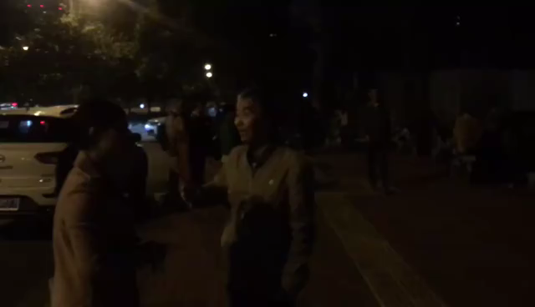

Slide 5
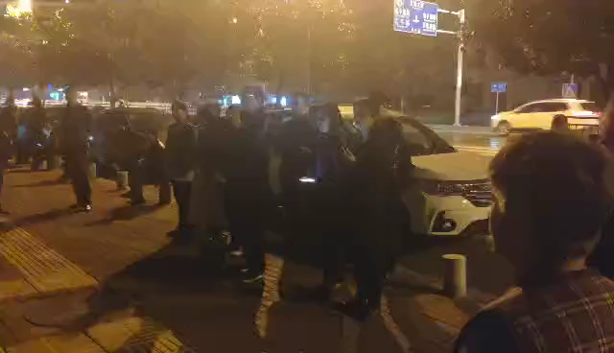

Slide 6
【马太福音 Matthew 11:16-19】
16 我可用什么比这世代呢？好像孩童坐在街市上招呼同伴，说：
"But to what shall I liken this generation? It is like children sitting in the marketplaces and calling to their companions,
17 ‘我们向你们吹笛，你们不跳舞；我们向你们举哀，你们不捶胸。’
and saying:"We played the flute for you, And you did not dance; We mourned to you, And you did not lament.'

Slide 7
【马太福音 Matthew 11:16-19】
18 约翰来了，也不吃，也不喝，人就说他是被鬼附着的；
For John came neither eating nor drinking, and they say, "He has a demon.'

Slide 8
【马太福音 Matthew 11:16-19】
19 人子来了，也吃也喝，人又说他是贪食好酒的人，是税吏和罪人的朋友。但智慧之子，总以智慧为是（有古卷作“但智慧在行为上就显为是”）。”
The Son of Man came eating and drinking, and they say, "Look, a glutton and a winebibber, a friend of tax collectors and sinners!' But wisdom is justified by her children."

Slide 9
【马太福音 Matthew 28:18-20】
18 耶稣进前来，对他们说：“天上地下所有的权柄都赐给我了。
Then Jesus came to them and said, "All authority in heaven and on earth has been given to me.

Slide 10
【马太福音 Matthew 28:18-20】
19 所以，你们要去，使万民作我的门徒，奉父、子、圣灵的名给他们施洗（或作“给他们施洗，归于父、子、圣灵的名”）。
Therefore go and make disciples of all nations, baptizing them in the name of the Father and of the Son and of the Holy Spirit,

Slide 11
【马太福音 Matthew 28:18-20】
20 凡我所吩咐你们的，都教训他们遵守，我就常与你们同在，直到世界的末了。”
and teaching them to obey everything I have commanded you. And surely I am with you always, to the very end of the age."

Slide 12
【启示录 Revelation 3:1-3】
1 “你要写信给撒狄教会的使者说，那有 神的七灵和七星的说：我知道你的行为，按名你是活的，其实是死的。
"And to the angel of the church in Sardis write, "These things says He who has the seven Spirits of God and the seven stars: "I know your works, that you have a name that you are alive, but you are dead.

Slide 13
【启示录 Revelation 3:1-3】
2 你要警醒，坚固那剩下将要衰微的（“衰微”原文作“死”），因我见你的行为，在我 神面前，没有一样是完全的。
Be watchful, and strengthen the things which remain, that are ready to die, for I have not found your works perfect before God.

Slide 14
【启示录 Revelation 3:1-3】
3 所以要回想你是怎样领受，怎样听见的，又要遵守，并要悔改。若不警醒，我必临到你那里，如同贼一样。我几时临到，你也决不能知道。
Remember therefore how you have received and heard; hold fast and repent. Therefore if you will not watch, I will come upon you as a thief, and you will not know what hour I will come upon you.

Slide 15
【启示录 Revelation 3:14-19】
14 “你要写信给老底嘉教会的使者说，那为阿们的，为诚信真实见证的，在 神创造万物之上为元首的，说：
"And to the angel of the church of the Laodiceans write, "These things says the Amen, the Faithful and True Witness, the Beginning of the creation of God:.

Slide 16
【启示录 Revelation 3:14-19】
15 我知道你的行为，你也不冷也不热，我巴不得你或冷或热。
"I know your works, that you are neither cold nor hot. I could wish you were cold or hot.
16 你既如温水，也不冷也不热，所以我必从我口中把你吐出去。
So then, because you are lukewarm, and neither cold nor hot, I will vomit you out of My mouth.

Slide 17
【启示录 Revelation 3:14-19】
17 你说：我是富足，已经发了财，一样都不缺；却不知道你是那困苦、可怜、贫穷、瞎眼、赤身的。
Because you say, "I am rich, have become wealthy, and have need of nothing'--and do not know that you are wretched, miserable, poor, blind, and naked--

Slide 18
【启示录 Revelation 3:14-19】
18 我劝你向我买火炼的金子，叫你富足；又买白衣穿上，叫你赤身的羞耻不露出来；又买眼药擦你的眼睛，使你能看见。
I counsel you to buy from Me gold refined in the fire, that you may be rich; and white garments, that you may be clothed, that the shame of your nakedness may not be revealed; and anoint your eyes with eye salve, that you may see.

Slide 19
【启示录 Revelation 3:14-19】
19 凡我所疼爱的，我就责备管教他，所以你要发热心，也要悔改。
As many as I love, I rebuke and chasten. Therefore be zealous and repent.

