Slide 1
雅各书 James 4:13-17
Boise Chinese Christian Church
4/12/2020

Slide 2
【雅各书 James 4:13-17】
13 嗐！你们有话说：“今天、明天我们要往某城里去，在那里住一年，作买卖得利。”
Come now, you who say, “Today or tomorrow we will go to such and such a city, spend a year there, buy and sell, and make a profit”;

Slide 3
【雅各书 James 4:13-17】
14 其实明天如何，你们还不知道。你们的生命是什么呢？你们原来是一片云雾，出现少时就不见了。
whereas you do not know what will happen tomorrow. For what is your life? It is even a vapor that appears for a little time and then vanishes away.

Slide 4
【雅各书 James 4:13-17】
15 你们只当说：“主若愿意，我们就可以活着，也可以作这事，或作那事。”
Instead you ought to say, “If the Lord wills, we shall live and do this or that.”
16 现今你们竟以张狂夸口，凡这样夸口都是恶的。
But now you boast in your arrogance. All such boasting is evil.

Slide 5
【雅各书 James 4:13-17】
17 人若知道行善，却不去行，这就是他的罪了。
Therefore, to him who knows to do good and does not do it, to him it is sin.

Slide 6
● 问题讨论 Question：
分享在这段经文中，哪一节经文（或短语词句）最触动我？为什么？我的理解是什么？
What do I think about James 4:13-17?
Which verse is a deep impact on me?
Why?

Slide 7
● 生命的画像 Pictures of Life
【雅各书 James 4:13-17】
14 其实明天如何，你们还不知道。你们的生命是什么呢？你们原来是一片云雾，出现少时就不见了。
whereas you do not know what will happen tomorrow. For what is your life? It is even a vapor that appears for a little time and then vanishes away.

Slide 8


Slide 9
【诗篇 Psalms 39:5-6】
5 你使我的年日窄如手掌。我一生的年数，在你面前如同无有。各人最稳妥的时候，真是全然虚幻。（细拉）
You have made my days a mere handbreadth; the span of my years is as nothing before you. Everyone is but a breath, even those who seem secure.

Slide 10
【诗篇 Psalms 39:5-6】
6 世人行动实系幻影。他们忙乱，真是枉然；积蓄财宝，不知将来有谁收取。
“Surely everyone goes around like a mere phantom; in vain they rush about, heaping up wealth without knowing whose it will finally be.

Slide 11
【诗篇 Psalms 90:9b-10】
9b ……我们度尽的年岁好像一声叹息。
….we finish our years with a moan.
10 我们一生的年日是七十岁，若是强壮可到八十岁；但其中所矜夸的不过是劳苦愁烦，转眼成空，我们便如飞而去。
Our days may come to seventy years, or eighty, if our strength endures; yet the best of them are but trouble and sorrow, for they quickly pass, and we fly away.

Slide 12
我们该怎样面对地上生命的真相？
How to deal with the reality of life?
➢ 不把自己看的太重要，就不会忧虑焦虑。
”I am not so important, so I can be happy in rough circumstances.”

Slide 13
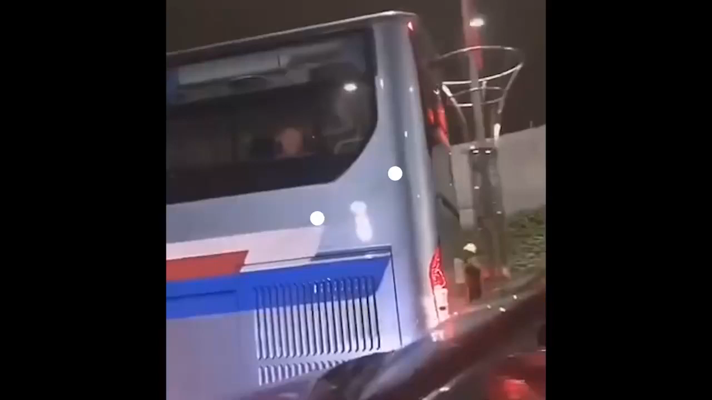

Slide 14
【马太福音 Matthew 11:28-29】
28 凡劳苦担重担的人，可以到我这里来，我就使你们得安息。
“Come to me, all you who are weary and burdened, and I will give you rest.
29 我心里柔和谦卑，你们当负我的轭，学我的样式，这样，你们心里就必得享安息。
Take my yoke upon you and learn from me, for I am gentle and humble in heart, and you will find rest for your souls.

Slide 15
我们该怎样面对地上生命的真相？
How to deal with the reality of life?
➢ 不把自己看的太重要。就不会忧虑焦虑。
”I am not so important, so I can be happy in rough circumstances.”
➢ 谦卑——被祝福的健忘症
Humility_ Blessed Self-Forgetfulness

Slide 16
我们该怎样面对地上生命的真相？
How to deal with the reality of life?
➢ 趁还有时间的时候，竭力行善
Make every effort to ……while we still have time.
【雅各书 James 4:17】人若知道行善，却不去行，这就是他的罪了。
Therefore, to him who knows to do good and does not do it, to him it is sin.

Slide 17
多马与复活的主
Thomas Encounters The Risen Lord
Boise Chinese Christian Church
4/12/2020 Easter

Slide 18
【约翰福音 John 20:24-29】
24 那十二个门徒中，有称为低土马的多马，耶稣来的时候，他没有和他们同在。
Now Thomas, called the Twin, one of the twelve, was not with them when Jesus came.

Slide 19
【约翰福音 John 20:24-29】
25 那些门徒就对他说：“我们已经看见主了。”多马却说：“我非看见他手上的钉痕，用指头探入那钉痕，又用手探入他的肋旁，我总不信。”
The other disciples therefore said to him, “We have seen the Lord.” So he said to them, “Unless I see in His hands the print of the nails, and put my finger into the print of the nails, and put my hand into His side, I will not believe.”

Slide 20
【约翰福音 John 20:24-29】
26 过了八日，门徒又在屋里，多马也和他们同在。门都关了，耶稣来站在当中说：“愿你们平安！”
And after eight days His disciples were again inside, and Thomas with them. Jesus came, the doors being shut, and stood in the midst, and said, “Peace to you!”

Slide 21
【约翰福音 John 20:24-29】
27 就对多马说：“伸过你的指头来，摸（“摸”原文作“看”）我的手；伸出你的手来，探入我的肋旁。不要疑惑，总要信。”
Then He said to Thomas, “Reach your finger here, and look at My hands; and reach your hand here, and put it into My side. Do not be unbelieving, but believing.”

Slide 22
【约翰福音 John 20:24-29】
28 多马说：“我的主，我的 神！”
And Thomas answered and said to Him, “My Lord and my God!”
29 耶稣对他说：“你因看见了我才信；那没有看见就信的有福了。”
Jesus said to him, “Thomas, because you have seen Me, you have believed. Blessed are those who have not seen and yet have believed.”

Slide 23
【创世记 Genesis 28:20-22】
20 雅各许愿说：“ 神若与我同在，在我所行的路上保佑我，又给我食物吃、衣服穿，
Then Jacob made a vow, saying, “If God will be with me, and keep me in this way that I am going, and give me bread to eat and clothing to put on,

Slide 24
【创世记 Genesis 28:20-22】
21 使我平平安安地回到我父亲的家，我就必以耶和华为我的 神，
so that I come back to my father’s house in peace, then the Lord shall be my God.
22 我所立为柱子的石头也必作 神的殿，凡你所赐给我的，我必将十分之一献给你。”
And this stone which I have set as a pillar shall be God’s house, and of all that You give me I will surely give a tenth to You.”

Slide 25
【但以理书 Daniel 3:17-18】
17 即便如此，我们所侍奉的 神，能将我们从烈火的窑中救出来。王啊，祂也必救我们脱离你的手；
If that is the case, our God whom we serve is able to deliver us from the burning fiery furnace, and He will deliver us from your hand, O king.

Slide 26
【但以理书 Daniel 3:17-18】
18 即或不然，王啊，你当知道我们决不侍奉你的神，也不敬拜你所立的金像！”
But if not, let it be known to you, O king, that we do not serve your gods, nor will we worship the gold image which you have set up.”

Slide 27
【希伯来书 Hebrews 11:1-2】
1 信就是所望之事的实底，是未见之事的确据。
Now faith is the substance of things hoped for, the evidence of things not seen.
2 古人在这信上得了美好的证据。
For by it the elders obtained a good testimony.

Slide 28
【希伯来书 Hebrews 11:13-16】
13 这些人都是存着信心死的，并没有得着所应许的，却从远处望见，且欢喜迎接，又承认自己在世上是客旅，是寄居的。
These all died in faith, not having received the promises, but having seen them afar off were assured of them, embraced them and confessed that they were strangers and pilgrims on the earth.

Slide 29
【希伯来书 Hebrews 11:13-16】
14 说这样话的人是表明自己要找一个家乡。
For those who say such things declare plainly that they seek a homeland.
15 他们若想念所离开的家乡，还有可以回去的机会。
And truly if they had called to mind that country from which they had come out, they would have had opportunity to return.

Slide 30
【希伯来书 Hebrews 11:13-16】
16 他们却羡慕一个更美的家乡，就是在天上的。所以 神被称为他们的 神，并不以为耻，因为祂已经给他们预备了一座城。
But now they desire a better, that is, a heavenly country. Therefore God is not ashamed to be called their God, for He has prepared a city for them.

Slide 31
【约翰福音 John 11:40】
耶稣说：“我不是对你说过，你若信，就必看见 神的荣耀吗？”
Jesus said to her, “Did I not say to you that if you would believe you would see the glory of God?”

Slide 32
【诗篇 Psalms 139:1-7】
1 （大卫的诗，交与伶长。）耶和华啊，你已经鉴察我，认识我。
（For the Chief Musician. A Psalm of David.）O Lord, You have searched me and known me.
2 我坐下，我起来，你都晓得，你从远处知道我的意念；
You know my sitting down and my rising up; You understand my thought afar off.

Slide 33
【诗篇 Psalms 139:1-7】
3 我行路，我躺卧，你都细察，你也深知我一切所行的。
You comprehend my path and my lying down, And are acquainted with all my ways.
4 耶和华啊，我舌头上的话，你没有一句不知道的。
For there is not a word on my tongue, But behold, O Lord, You know it altogether.

Slide 34
【诗篇 Psalms 139:1-7】
5 你在我前后环绕我，按手在我身上。
You have hedged me behind and before, And laid Your hand upon me.
6 这样的知识奇妙，是我不能测的；至高，是我不能及的。
Such knowledge is too wonderful for me; It is high, I cannot attain it.

Slide 35
【诗篇 Psalms 139:1-7】
7 我往哪里去，躲避你的灵？我往哪里逃，躲避你的面？
Where can I go from Your Spirit? Or where can I flee from Your presence?

Slide 36
【彼得后书 2 Peter 3:3,4,9】
3 第一要紧的，该知道在末世必有好讥诮的人，随从自己的私欲出来讥诮说：
knowing this first: that scoffers will come in the last days, walking according to their own lusts,

Slide 37
【彼得后书 2 Peter 3:3,4,9】
4 “主要降临的应许在哪里呢？因为从列祖睡了以来，万物与起初创造的时候仍是一样。”
and saying, “Where is the promise of His coming? For since the fathers fell asleep, all things continue as they were from the beginning of creation.”

Slide 38
【彼得后书 2 Peter 3:3,4,9】
9 主所应许的尚未成就，有人以为祂是耽延，其实不是耽延，乃是宽容你们，不愿有一人沉沦，乃愿人人都悔改。
The Lord is not slack concerning His promise, as some count slackness, but is longsuffering toward us, not willing that any should perish but that all should come to repentance.

Slide 39
【约翰福音 John 20:29】
耶稣对他说：“你因看见了我才信；那没有看见就信的有福了。”
Jesus said to him, “Thomas, because you have seen Me, you have believed. Blessed are those who have not seen and yet have believed.”

Slide 40
【哥林多前书 1 Corinthians 15:11-23】
11 不拘是我，是众使徒，我们如此传，你们也如此信了。
Therefore, whether it was I or they, so we preach and so you believed.
12 既传基督是从死里复活了，怎么在你们中间有人说没有死人复活的事呢？
Now if Christ is preached that He has been raised from the dead, how do some among you say that there is no resurrection of the dead?

Slide 41
【哥林多前书 1 Corinthians 15:11-23】
13 若没有死人复活的事，基督也就没有复活了。
But if there is no resurrection of the dead, then Christ is not risen.
14 若基督没有复活，我们所传的便是枉然，你们所信的也是枉然，
And if Christ is not risen, then our preaching is empty and your faith is also empty.

Slide 42
【哥林多前书 1 Corinthians 15:11-23】
15 并且明显我们是为 神妄作见证的，因我们见证 神是叫基督复活了。若死人真不复活， 神也就没有叫基督复活了。
Yes, and we are found false witnesses of God, because we have testified of God that He raised up Christ, whom He did not raise up—if in fact the dead do not rise.
16 因为死人若不复活，基督也就没有复活了。
For if the dead do not rise, then Christ is not risen.

Slide 43
【哥林多前书 1 Corinthians 15:11-23】
17 基督若没有复活，你们的信便是徒然，你们仍在罪里，
And if Christ is not risen, your faith is futile; you are still in your sins!
18 就是在基督里睡了的人也灭亡了。
Then also those who have fallen asleep in Christ have perished.

Slide 44
【哥林多前书 1 Corinthians 15:11-23】
19 我们若靠基督只在今生有指望，就算比众人更可怜。
If in this life only we have hope in Christ, we are of all men the most pitiable.
20 但基督已经从死里复活，成为睡了之人初熟的果子。
But now Christ is risen from the dead, and has become the firstfruits of those who have fallen asleep.

Slide 45
【哥林多前书 1 Corinthians 15:11-23】
21 死既是因一人而来，死人复活也是因一人而来。
For since by man came death, by Man also came the resurrection of the dead.
22 在亚当里众人都死了，照样，在基督里众人也都要复活。
For as in Adam all die, even so in Christ all shall be made alive.

Slide 46
【哥林多前书 1 Corinthians 15:11-23】
23 但各人是按着自己的次序复活，初熟的果子是基督，以后在祂来的时候，是那些属基督的。
But each one in his own order: Christ the firstfruits, afterward those who are Christ’s at His coming.

Slide 47
【哥林多后书 2 Corinthians 5:15】
并且祂替众人死，是叫那些活着的人不再为自己活，乃为替他们死而复活的主活。
and He died for all, that those who live should live no longer for themselves, but for Him who died for them and rose again.

Slide 48
信仰告白
Confession of Faith
Boise Chinese Christian Church

Slide 49
使徒信经 Apostles' Creed
我信上帝，全能的父，创造天地的主。 我信我主耶稣基督，上帝的独生子； 因着圣灵感孕，从童贞女马利亚所生； 在本丢彼拉多手下受难，被钉在十字架上，受死，埋葬； | I believe in God the Father, Almighty, Maker of heaven and earth: And in Jesus Christ, his only begotten Son, our Lord: Who was conceived by the Holy Ghost, born of the Virgin Mary: Suffered under Pontius Pilate; was crucified, dead and buried: He descended into hell:

Slide 50
使徒信经 Apostles' Creed
降在阴间；第三天从死里复活； 后升天，坐在全能父上帝的右边； 将来必从那里降临，审判活人，死人。 我信圣灵； | The third day he rose again from the dead: He ascended into heaven, and sits at the right hand of God the Father Almighty: From thence he shall come to judge the quick and the dead: I believe in the Holy Ghost:

Slide 51
使徒信经 Apostles' Creed
我信圣而公之教会； 我信圣徒相通； 我信罪得赦免， 我信身体复活； 我信永生。阿们！ | I believe in the holy universal church: the communion of saints: The forgiveness of sins: The resurrection of the body: And the life everlasting. Amen.

Slide 52
祝祷 Benediction
【希伯来书 13:20-21】 但愿赐平安的神，就是那凭永约之血使群羊的大牧人、我主耶稣从死里复活的神， 在各样善事上成全你们，叫你们遵行祂的旨意，又藉着耶稣基督在你们心里行祂所喜悦的事。 愿荣耀归给祂，直到永永远远。阿们！ | 【Hebrews 13:20-21】 Now may the God of peace who brought up our Lord Jesus from the dead, that great Shepherd of the sheep, through the blood of the everlasting covenant, make you complete in every good work to do His will, working in you what is well pleasing in His sight, through Jesus Christ, to whom be glory forever and ever. Amen.

