Slide 1
羊的門
The Door of The Sheep
Boise Chinese Christian Church
05/16/2021

Slide 2
【約翰福音 John 10:9】
我就是門，凡從我進來的，必然得救，幷且出入得草吃。
I am the door. If anyone enters by Me, he will be saved, and will go in and out and find pasture.

Slide 3
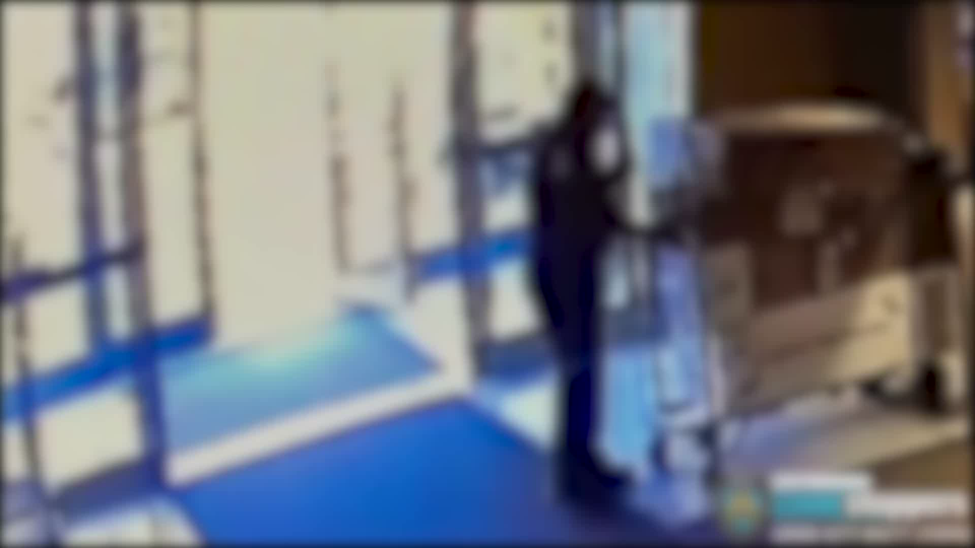

Slide 4
【創世記 Genesis 3:23-24】
23 耶和華 神便打發他出伊甸園去，耕種他所自出之土。
therefore the Lord God sent him out of the garden of Eden to till the ground from which he was taken.
24 于是把他趕出去了。又在伊甸園的東邊安設基路伯，和四面轉動發火焰的劍，要把守生命樹的道路。 So He drove out the man; and He placed cherubim at the east of the garden of Eden, and a flaming sword which turned every way, to guard the way to the tree of life.

Slide 5
【約翰福音 John 10:9】
我就是門，凡從我進來的，必然 得救，幷且出入得草吃。
I am the door. If anyone enters by Me, he will be saved, and will go in and out and find pasture.

Slide 6
【路加福音 Luke 4:18】
“主的靈在我身上，因爲祂用膏膏我，叫我傳福音給貧窮的人；差遣我報告：被擄的得釋放，瞎眼的得看見，叫那受壓制的得自由，
“The Spirit of the Lord is upon Me, Because He has anointed Me To preach the gospel to the poor; He has sent Me to heal the brokenhearted, To proclaim liberty to the captives And recovery of sight to the blind, To set at liberty those who are oppressed;

Slide 7
【約翰福音 John 10:9】
我就是門，凡從我進來的，必然得救，幷且出入得草吃。
I am the door. If anyone enters by Me, he will be saved, and will go in and out and find pasture.

Slide 8
【約翰福音 John 8:32】
你們必曉得真理，真理必叫你們得以自由。”
And you shall know the truth, and the truth shall make you free.”

Slide 9
【約翰福音 John 4:13-14】
13 耶穌回答說：“凡喝這水的，還要再渴；
Jesus answered and said to her, “Whoever drinks of this water will thirst again,
14 人若喝我所賜的水，就永遠不渴。我所賜的水要在他裏頭成爲泉源，直涌到永生。”
but whoever drinks of the water that I shall give him will never thirst. But the water that I shall give him will become in him a fountain of water springing up into everlasting life.”

Slide 10
【約翰福音 John 10:9】
我就是門，凡從我進來的，必然得救，幷且出入得草吃。
I am the door. If anyone enters by Me, he will be saved, and will go in and out and find pasture.

Slide 11
【約翰福音 John 6: 35，47，48，63】
35 耶穌說：“我就是生命的糧，到我這裏來的，必定不餓；信我的，永遠不渴。
And Jesus said to them, “I am the bread of life. He who comes to Me shall never hunger, and he who believes in Me shall never thirst.
47 我實實在在地告訴你們，信的人有永生。
Most assuredly, I say to you, he who believes in Me has everlasting life.

Slide 12
【約翰福音 John 6: 35，47，48，63】
48 我就是生命的糧。
I am the bread of life.
63 叫人活著的乃是靈，肉體是無益的。我對你們所說的話就是靈，就是生命。
It is the Spirit who gives life; the flesh profits nothing. The words that I speak to you are spirit, and they are life.

Slide 13
【約翰福音 John 10:9】
我就是門，凡從我進來的，必然得救，幷且出入得草吃。
I am the door. If anyone enters by Me, he will be saved, and will go in and out and find pasture.

Slide 14
【歌羅西書 Colossians 西3:11】
在此幷不分希臘人、猶太人、受割禮的、未受割禮的、化外人、西古提人、爲奴的、自主的，惟有基督是包括一切，又住在各人之內。
where there is neither Greek nor Jew, circumcised nor uncircumcised, barbarian, Scythian, slave nor free, but Christ is all and in all.

Slide 15
【路加福音 Luke 13:29】
從東、從西、從南、從北將有人來，在 神的國裏坐席。
They will come from the east and the west, from the north and the south, and sit down in the kingdom of God.

Slide 16
【路加福音 Luke 14:16-20】
16 耶穌對他說：“有一人擺設大筵席，請了許多客。
Then He said to him, "A certain man gave a great supper and invited many,
17 到了坐席的時候，打發僕人去對所請的人說：‘請來吧！樣樣都齊備了。’
and sent his servant at supper time to say to those who were invited, "Come, for all things are now ready.'

Slide 17
【路加福音 Luke 14:16-20】
18 衆人一口同音地推辭。頭一個說：‘我買了一塊地，必須去看看。請你准我辭了。’
But they all with one accord began to make excuses. The first said to him, "I have bought a piece of ground, and I must go and see it. I ask you to have me excused.'
19 又有一個說：‘我買了五對牛，要去試一試。請你准我辭了。’And another said, "I have bought five yoke of oxen, and I am going to test them. I ask you to have me excused.'

Slide 18
【路加福音 Luke 14:16-20】
20 又有一個說：‘我才娶了妻，所以不能去。’
Still another said, "I have married a wife, and therefore I cannot come.'

Slide 19
【羅馬書 Romans 3:22-24】
22 就是 神的義，因信耶穌基督加給一切相信的人，幷沒有分別。
even the righteousness of God, through faith in Jesus Christ, to all and on all who believe. For there is no difference;
23 因爲世人都犯了罪，虧缺了 神的榮耀，for all have sinned and fall short of the glory of God,

Slide 20
【羅馬書 Romans 3:22-24】
24 如今却蒙 神的恩典，因基督耶穌的救贖，就白白地稱義。
being justified freely by His grace through the redemption that is in Christ Jesus,

Slide 21
【啓示錄 Revelation 22:16-17】
16 “我耶穌差遣我的使者爲衆教會將這些事向你們證明。我是大衛的根，又是他的後裔。我是明亮的晨星。”
“I, Jesus, have sent My angel to testify to you these things in the churches. I am the Root and the Offspring of David, the Bright and Morning Star.”

Slide 22
【啓示錄 Revelation 22:16-17】
17 聖靈和新婦都說：“來！”聽見的人也該說：“來！”口渴的人也當來；願意的，都可以白白取生命的水喝。
And the Spirit and the bride say, “Come!” And let him who hears say, “Come!” And let him who thirsts come. Whoever desires, let him take the water of life freely.

Slide 23
【希伯來書 Hebrews 10:19-25】
19 弟兄們，我們既因耶穌的血得以坦然進入至聖所，
Therefore, brethren, having boldness to enter the Holiest by the blood of Jesus,
20 是藉著祂給我們開了一條又新、又活的路從幔子經過，這幔子就是祂的身體。
by a new and living way which He consecrated for us, through the veil, that is, His flesh,

Slide 24
【希伯來書 Hebrews 10:19-25】
21 又有一位大祭司治理 神的家。
and having a High Priest over the house of God,
22 幷我們心中天良的虧欠已經灑去，身體用清水洗淨了，就當存著誠心和充足的信心來到 神面前，
let us draw near with a true heart in full assurance of faith, having our hearts sprinkled from an evil conscience and our bodies washed with pure water.

Slide 25
【希伯來書 Hebrews 10:19-25】
23 也要堅守我們所承認的指望，不至搖動，因爲那應許我們的是信實的。
Let us hold fast the confession of our hope without wavering, for He who promised is faithful.
24 又要彼此相顧，激發愛心，勉勵行善。
And let us consider one another in order to stir up love and good works,

Slide 26
【希伯來書 Hebrews 10:19-25】
25 你們不可停止聚會，好像那些停止慣了的人，倒要彼此勸勉。既知道（原文作“看見”）那日子臨近，就更當如此。
not forsaking the assembling of ourselves together, as is the manner of some, but exhorting one another, and so much the more as you see the Day approaching.

