Slide 1
好父親
Good Father
Boise Chinese Christian Church
06/20/2021

Slide 2
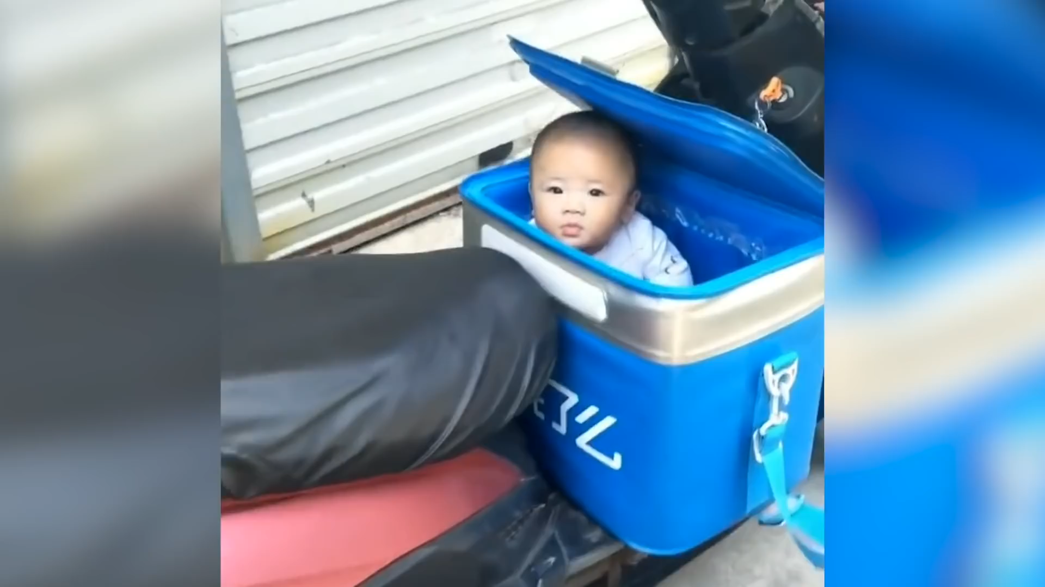

Slide 3
【約翰一書 1 John 2:13-17】
13 父老啊，我寫信給你們，因爲你們認識那從起初原有的。少年人哪，我寫信給你們，因爲你們勝了那惡者。小子們哪，我曾寫信給你們，因爲你們認識父。
I write to you, fathers, Because you have known Him who is from the beginning. I write to you, young men, Because you have overcome the wicked one. I write to you, little children, Because you have known the Father.

Slide 4
【約翰一書 1 John 2:13-17】
14 父老啊，我曾寫信給你們，因爲你們認識那從起初原有的。少年人哪，我曾寫信給你們，因爲你們剛强， 神的道常存在你們心裏，你們也勝了那惡者。
I have written to you, fathers, Because you have known Him who is from the beginning. I have written to you, young men, Because you are strong, and the word of God abides in you, And you have overcome the wicked one.

Slide 5
【約翰一書 1 John 2:13-17】
15 不要愛世界和世界上的事。人若愛世界，愛父的心就不在他裏面了。
Do not love the world or the things in the world. If anyone loves the world, the love of the Father is not in him.
16 因爲凡世界上的事，就像肉體的情欲，眼目的情欲，幷今生的驕傲，都不是從父來的，乃是從世界來的。For all that is in the world—the lust of the flesh, the lust of the eyes, and the pride of life—is not of the Father but is of the world.

Slide 6
【約翰一書 1 John 2:13-17】
17 這世界和其上的情欲都要過去，惟獨遵行 神旨意的，是永遠常存。
And the world is passing away, and the lust of it; but he who does the will of God abides forever.

Slide 7
【約翰一書 1 John 2:13-14】
13 父老啊，我寫信給你們，因爲你們認識那從起初原有的。少年人哪，我寫信給你們，因爲你們勝了那惡者。小子們哪，我曾寫信給你們，因爲你們認識父。
I write to you, fathers, Because you have known Him who is from the beginning. I write to you, young men, Because you have overcome the wicked one. I write to you, little children, Because you have known the Father.

Slide 8
【約翰一書 1 John 2:13-14】
14 父老啊，我曾寫信給你們，因爲你們認識那從起初原有的。少年人哪，我曾寫信給你們，因爲你們剛强， 神的道常存在你們心裏，你們也勝了那惡者。
I have written to you, fathers, Because you have known Him who is from the beginning. I have written to you, young men, Because you are strong, and the word of God abides in you, And you have overcome the wicked one.

Slide 9
【創世記 Genesis 17:3-5】
3 亞伯蘭俯伏在地， 神又對他說： Then Abram fell on his face, and God talked with him, saying:
4 “我與你立約，你要作多國的父。
“As for Me, behold, My covenant is with you, and you shall be a father of many nations.
5 從此以後，你的名不再叫亞伯蘭，要叫亞伯拉罕，因爲我已立你作多國的父。
No longer shall your name be called Abram, but your name shall be Abraham; for I have made you a father of many nations.

Slide 10
【創世記 Genesis 22:1-19】
1 這些事以後， 神要試驗亞伯拉罕，就呼叫他說：“亞伯拉罕！”他說：“我在這裏。”
Now it came to pass after these things that God tested Abraham, and said to him, “Abraham!”And he said, “Here I am.”
2 神說：“你帶著你的兒子，就是你獨生的兒子，你所愛的以撒，往摩利亞地去，在我所要指示你的山上，把他獻爲燔祭。” Then He said, “Take now your son, your only son Isaac, whom you love, and go to the land of Moriah, and offer him there as a burnt offering on one of the mountains of which I shall tell you.”

Slide 11
【創世記 Genesis 22:1-19】
3 亞伯拉罕清早起來，備上驢，帶著兩個僕人和他兒子以撒，也劈好了燔祭的柴，就起身往 神所指示他的地方去了。
So Abraham rose early in the morning and saddled his donkey, and took two of his young men with him, and Isaac his son; and he split the wood for the burnt offering, and arose and went to the place of which God had told him.
4 到了第三日，亞伯拉罕舉目遠遠地看見那地方。
Then on the third day Abraham lifted his eyes and saw the place afar off.

Slide 12
【創世記 Genesis 22:1-19】
5 亞伯拉罕對他的僕人說：“你們和驢在此等候，我與童子往那裏去拜一拜，就回到你們這裏來。”
And Abraham said to his young men, “Stay here with the donkey; the lad and I will go yonder and worship, and we will come back to you.”
6 亞伯拉罕把燔祭的柴放在他兒子以撒身上，自己手裏拿著火與刀，于是二人同行。
So Abraham took the wood of the burnt offering and laid it on Isaac his son; and he took the fire in his hand, and a knife, and the two of them went together.

Slide 13
【創世記 Genesis 22:1-19】
7 以撒對他父親亞伯拉罕說：“父親哪！”亞伯拉罕說：“我兒，我在這裏。”以撒說：“請看，火與柴都有了，但燔祭的羊羔在哪裏呢？”
But Isaac spoke to Abraham his father and said, “My father!”And he said, “Here I am, my son.”Then he said, “Look, the fire and the wood, but where is the lamb for a burnt offering?”
8 亞伯拉罕說：“我兒， 神必自己預備作燔祭的羊羔。”于是二人同行。 And Abraham said, “My son, God will provide for Himself the lamb for a burnt offering.” So the two of them went together.

Slide 14
【創世記 Genesis 22:1-19】
9 他們到了 神所指示的地方，亞伯拉罕在那裏築壇，把柴擺好，捆綁他的兒子以撒，放在壇的柴上。
Then they came to the place of which God had told him. And Abraham built an altar there and placed the wood in order; and he bound Isaac his son and laid him on the altar, upon the wood.
10 亞伯拉罕就伸手拿刀，要殺他的兒子。
And Abraham stretched out his hand and took the knife to slay his son.

Slide 15
【創世記 Genesis 22:1-19】
11 耶和華的使者從天上呼叫他說：“亞伯拉罕！亞伯拉罕！”他說：“我在這裏。” But the Angel of the Lord called to him from heaven and said, “Abraham, Abraham!”So he said, “Here I am.”
12 天使說：“你不可在這童子身上下手，一點不可害他。現在我知道你是敬畏 神的了，因爲你沒有將你的兒子，就是你獨生的兒子，留下不給我。”
And He said, “Do not lay your hand on the lad, or do anything to him; for now I know that you fear God, since you have not withheld your son, your only son, from Me.”

Slide 16
【創世記 Genesis 22:1-19】
13 亞伯拉罕舉目觀看，不料，有一隻公羊，兩角扣在稠密的小樹中，亞伯拉罕就取了那只公羊來，獻爲燔祭，代替他的兒子。Then Abraham lifted his eyes and looked, and there behind him was a ram caught in a thicket by its horns. So Abraham went and took the ram, and offered it up for a burnt offering instead of his son.
14 亞伯拉罕給那地方起名叫耶和華以勒（意思就是“耶和華必預備”），直到今日人還說：“在耶和華的山上必有預備。” And Abraham called the name of the place, The-Lord-Will-Provide; as it is said to this day, “In the Mount of the Lord it shall be provided.”

Slide 17
【創世記 Genesis 22:1-19】
15 耶和華的使者第二次從天上呼叫亞伯拉罕說：
Then the Angel of the Lord called to Abraham a second time out of heaven,
16 “耶和華說：‘你既行了這事，不留下你的兒子，就是你獨生的兒子，我便指著自己起誓說：
and said: “By Myself I have sworn, says the Lord, because you have done this thing, and have not withheld your son, your only son—

Slide 18
【創世記 Genesis 22:1-19】
17 論福，我必賜大福給你；論子孫，我必叫你的子孫多起來，如同天上的星，海邊的沙。你子孫必得著仇敵的城門， blessing I will bless you, and multiplying I will multiply your descendants as the stars of the heaven and as the sand which is on the seashore; and your descendants shall possess the gate of their enemies.
18 幷且地上萬國都必因你的後裔得福，因爲你聽從了我的話。’” In your seed all the nations of the earth shall be blessed, because you have obeyed My voice.”

Slide 19
【創世記 Genesis 22:1-19】
19 于是亞伯拉罕回到他僕人那裏，他們一同起身往別是巴去，亞伯拉罕就住在別是巴。
So Abraham returned to his young men, and they rose and went together to Beersheba; and Abraham dwelt at Beersheba.

Slide 20
【創世記 Genesis 22:14】
亞伯拉罕給那地方起名叫耶和華以勒（意思就是“耶和華必預備”），直到今日人還說：“在耶和華的山上必有預備。”
And Abraham called the name of the place, The-Lord-Will-Provide; as it is said to this day, “In the Mount of the Lord it shall be provided.”

Slide 21
【羅馬書 Romans 4:17】
亞伯拉罕所信的，是那叫死人復活、使無變爲有的 神，他在主面前作我們世人的父。如經上所記：“我已經立你作多國的父。”
(as it is written, “I have made you a father of many nations”) in the presence of Him whom he believed—God, who gives life to the dead and calls those things which do not exist as though they did;

Slide 22
【希伯來書 Hebrews 11:17-19】
17 亞伯拉罕因著信，被試驗的時候，就把以撒獻上，這便是那歡喜領受應許的，將自己獨生的兒子獻上。
By faith Abraham, when he was tested, offered up Isaac, and he who had received the promises offered up his only begotten son,
18 論到這兒子，曾有話說：“從以撒生的才要稱爲你的後裔。” of whom it was said, “In Isaac your seed shall be called,”

Slide 23
【希伯來書 Hebrews 11:17-19】
19 他以爲 神還能叫人從死裏復活，他也仿佛從死中得回他的兒子來。
concluding that God was able to raise him up, even from the dead, from which he also received him in a figurative sense.

Slide 24
【希伯來書 Hebrews 12:6-10】
6 因爲主所愛的，祂必管教，又鞭打凡所收納的兒子。”
For whom the Lord loves He chastens, And scourges every son whom He receives.”
7 你們所忍受的，是 神管教你們，待你們如同待兒子。焉有兒子不被父親管教的呢？
If you endure chastening, God deals with you as with sons; for what son is there whom a father does not chasten?

Slide 25
【希伯來書 Hebrews 12:6-10】
8 管教原是衆子所共受的，你們若不受管教，就是私子，不是兒子了。 But if you are without chastening, of which all have become partakers, then you are illegitimate and not sons.
9 再者，我們曾有生身的父管教我們，我們尚且敬重他；何况萬靈的父，我們豈不更當順服祂得生嗎？ Furthermore, we have had human fathers who corrected us, and we paid them respect. Shall we not much more readily be in subjection to the Father of spirits and live?

Slide 26
【希伯來書 Hebrews 12:6-10】
10 生身的父都是暫隨己意管教我們，惟有萬靈的父管教我們，是要我們得益處，使我們在祂的聖潔上有份。
For they indeed for a few days chastened us as seemed best to them, but He for our profit, that we may be partakers of His holiness.

Slide 27
【約翰一書 1 John 2:13-17】
13 父老啊，我寫信給你們，因爲你們認識那從起初原有的。少年人哪，我寫信給你們，因爲你們勝了那惡者。小子們哪，我曾寫信給你們，因爲你們認識父。
I write to you, fathers, Because you have known Him who is from the beginning. I write to you, young men, Because you have overcome the wicked one. I write to you, little children, Because you have known the Father.

Slide 28
【約翰一書 1 John 2:13-17】
14 父老啊，我曾寫信給你們，因爲你們認識那從起初原有的。少年人哪，我曾寫信給你們，因爲你們剛强， 神的道常存在你們心裏，你們也勝了那惡者。
I have written to you, fathers, Because you have known Him who is from the beginning. I have written to you, young men, Because you are strong, and the word of God abides in you, And you have overcome the wicked one.

Slide 29
【約翰一書 1 John 2:13-17】
15 不要愛世界和世界上的事。人若愛世界，愛父的心就不在他裏面了。
Do not love the world or the things in the world. If anyone loves the world, the love of the Father is not in him.
16 因爲凡世界上的事，就像肉體的情欲，眼目的情欲，幷今生的驕傲，都不是從父來的，乃是從世界來的。For all that is in the world—the lust of the flesh, the lust of the eyes, and the pride of life—is not of the Father but is of the world.

Slide 30
【約翰一書 1 John 2:13-17】
17 這世界和其上的情欲都要過去，惟獨遵行 神旨意的，是永遠常存。
And the world is passing away, and the lust of it; but he who does the will of God abides forever.

Slide 31
【申命記 Deuteronomy 6:4-7】
4 “以色列啊，你要聽！耶和華我們 神是獨一的主。
“Hear, O Israel: The Lord our God, the Lord is one!
5 你要盡心、盡性、盡力愛耶和華你的 神。
You shall love the Lord your God with all your heart, with all your soul, and with all your strength.

Slide 32
【申命記 Deuteronomy 6:4-7】
6 我今日所吩咐你的話都要記在心上，
“And these words which I command you today shall be in your heart.
7 也要殷勤教訓你的兒女，無論你坐在家裏，行在路上，躺下，起來，都要談論；
You shall teach them diligently to your children, and shall talk of them when you sit in your house, when you walk by the way, when you lie down, and when you rise up.

