Slide 1

主日信息

Slide 2
得荣耀的基督
The Glorified Christ
Boise Chinese Christian Church
7/17/2022

Slide 3
【约翰福音 John 17:1】
耶稣说了这话，就举目望天说：“父啊，时候到了，愿你荣耀你的儿子，使儿子也荣耀你；
Jesus spoke these words, lifted up His eyes to heaven, and said: “Father, the hour has come. Glorify Your Son, that Your Son also may glorify You,

Slide 4
【箴言 Proverbs 16:4a】
神所造的，都是为祂自己造的……（直译）
The LORD has made all for Himself….(NKJV)
【以赛亚书 Isaiah 43:21】
这百姓是我为自己所造的，好述说我的美德。”
This people I have formed for Myself; They shall declare My praise.

Slide 5
【出埃及记 Exodus 9:16】
其实我叫你存立，是特要向你显我的大能，并要使我的名传遍天下。
But indeed for this purpose I have raised you up, that I may show My power in you, and that My name may be declared in all the earth.

Slide 6
【耶利米书 Jeremiah 13:11a】
耶和华说：腰带怎样紧贴人腰，照样，我也使以色列全家和犹大全家紧贴我，好叫他们属我为子民，使我得名声，得颂赞，得荣耀……”
For as a belt is bound around a man's waist, so I bound the whole house of Israel and the whole house of Judah to me,' declares the Lord , 'to be my people for my renown and praise and honor….'

Slide 7
【彼得前书 1 Peter 2:9】
惟有你们是被拣选的族类，是有君尊的祭司，是圣洁的国度，是属 神的子民，要叫你们宣扬那召你们出黑暗、入奇妙光明者的美德。
But you are a chosen generation, a royal priesthood, a holy nation, His own special people, that you may proclaim the praises of Him who called you out of darkness into His marvelous light;

Slide 8
【以弗所书 Ephesians 1:5,6,12,14】
5 又因爱我们，就按着自己意旨所喜悦的，预定我们藉着耶稣基督得儿子的名分，
having predestined us to adoption as sons by Jesus Christ to Himself, according to the good pleasure of His will,
6 使祂荣耀的恩典得着称赞。这恩典是祂在爱子里所赐给我们的。
to the praise of the glory of His grace, by which He made us accepted in the Beloved.

Slide 9
【以弗所书 Ephesians 1:5,6,12,14】
12 叫祂的荣耀，从我们这首先在基督里有盼望的人可以得着称赞。
that we who first trusted in Christ should be to the praise of His glory.
14 这圣灵是我们得基业的凭据（原文作“质”），直等到 神之民（“民”原文作“产业”）被赎，使祂的荣耀得着称赞。
who is the guarantee of our inheritance until the redemption of the purchased possession, to the praise of His glory.

Slide 10
【罗马书 Romans 6:1-2】
1 这样，怎么说呢？我们可以仍在罪中，叫恩典显多吗？
What shall we say then? Shall we continue in sin that grace may abound?
2 断乎不可！我们在罪上死了的人岂可仍在罪中活着呢？
Certainly not! How shall we who died to sin live any longer in it?

Slide 11
【哥林多前书 1 Corinthians 10:31】
所以，你们或吃或喝，无论作什么，都要为荣耀 神而行。
Therefore, whether you eat or drink, or whatever you do, do all to the glory of God.

Slide 12
【马太福音 Matthew 26:53-54】
53 你想我不能求我父现在为我差遣十二营多天使来吗？
Or do you think that I cannot now pray to My Father, and He will provide Me with more than twelve legions of angels?
54 若是这样，经上所说事情必须如此的话怎么应验呢？”
How then could the Scriptures be fulfilled, that it must happen thus?”

Slide 13
【以赛亚书 Isaiah 53:7】
祂被欺压，在受苦的时候却不开口（或作“祂受欺压，却自卑不开口”），祂像羊羔被牵到宰杀之地，又像羊在剪毛的人手下无声，祂也是这样不开口。
He was oppressed and He was afflicted, Yet He opened not His mouth; He was led as a lamb to the slaughter, And as a sheep before its shearers is silent, So He opened not His mouth.

Slide 14
【路加福音 Luke 23:34】
当下耶稣说：“父啊，赦免他们！因为他们所作的，他们不晓得。”兵丁就拈阄分祂的衣服。
Then Jesus said, “Father, forgive them, for they do not know what they do.” And they divided His garments and cast lots.

Slide 15
【约翰福音 John 17:1】
耶稣说了这话，就举目望天说：“父啊，时候到了，愿你荣耀你的儿子，使儿子也荣耀你；
Jesus spoke these words, lifted up His eyes to heaven, and said: “Father, the hour has come. Glorify Your Son, that Your Son also may glorify You,

Slide 16
三一頌 Doxology
讚美真神萬福之根
世上萬民讚美主恩
天使天軍讚美主名
贊美聖父聖子聖靈 阿門
Praise God, from whom all blessings flow;
Praise Him, all creatures here below;
Praise Him above, ye heavenly host;
Praise Father, Son and Holy Ghost. Amen!

Slide 17
报告事项
Announcement

Slide 18


Slide 19
目前參加敎會聚會帶口罩的要求仍為自主彈性。
根據CDC的有關規定，感染新冠, 7天隔離,新冠檢測陰性後，再參加教會實體聚會 。密接，外出旅遊或出差, 如有搭乘大眾交通運輸工具, 新冠檢測陰性後, 再參加教會實體聚會。
The requirement of masks for onsite church gatherings is still optional mask wearing. If you are tested positive for COVID-19, please don’t attend in-person church gathering for 7 days, and then atten till you test negative. If you have close contact to a person who tests positive or take public transportation for your trip, please confirm COVID-19 (PCR or antigen) negative before returning to in-person gathering.

Slide 20
鼓勵大家參加教會活動：
周二姊妹會暂停（学生暑假).
周二晚7點禱告會，周五晚7:30查經: 申命記;
成人主日學: 啟示錄。
We encourage everyone to participate our church’s activities: Tue 10am sisters fellowship via Zoom, Tue 7pm prayer meeting, Fri 7:30pm bible study (Deuteronomy), and the Adult Sunday School is studying the book of Revelation.

Slide 21
教會暑假青少年特别查经活動：
从6/20开始，周一到周四晚上9：00-9：30教会通过Zoom带领初高中生查罗马书。欢迎初高中生参加。
From 6/20, our church will have Bible Study on book of Romans via Zoom for Junior High and High School students. The time is 9:00-9:30 PM from Monday to Thursday. All Junior High and High School students are welcome to join.

Slide 22
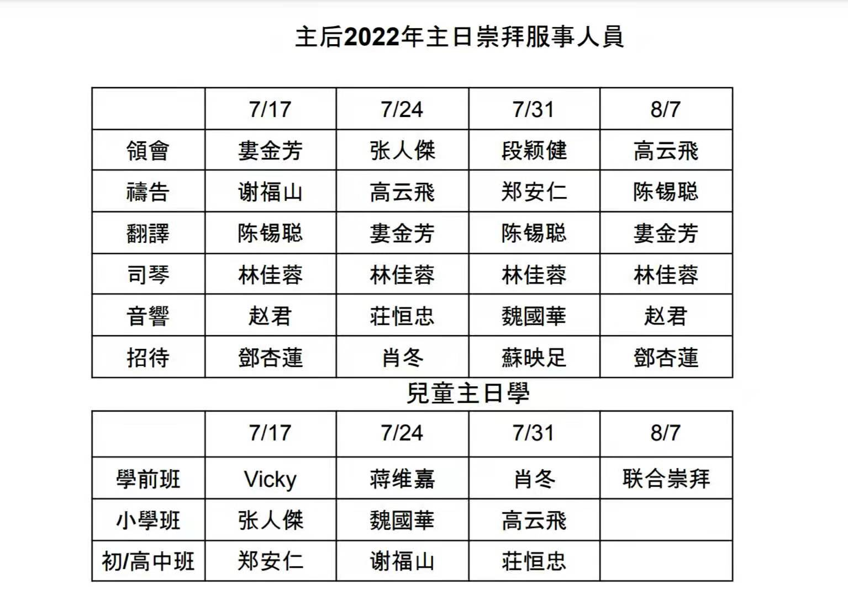

Slide 23
7/10 奉献 offering：
General $730

Slide 24
如果有任何奉献，请放到教会奉献箱或将
支票寄到教会邮箱。
If you have offering, please put it in the Offer Box or send the check to church’s mail.
Boise Chinese Christian Church
1422 N Eldorado St.
Boise, ID 83704

Slide 25
信仰告白
Apostle’s Creed
Boise Chinese Christian Church

Slide 26
使徒信經 Apostles' Creed
我信上帝，全能的父，創造天地的主。 我信我主耶穌基督，上帝的獨生子； 因著聖靈感孕，從童貞女馬利亞所生；在本丟彼拉多手下受難，被釘在十字架上，受死，埋葬； | I believe in God the Father, Almighty, Maker of heaven and earth: And in Jesus Christ, his only begotten Son, our Lord: Who was conceived by the Holy Ghost, born of the Virgin Mary: Suffered under Pontius Pilate; was crucified, dead and buried: He descended into hell:

Slide 27
使徒信經 Apostles' Creed
降在陰間；第三天從死裏復活； 後升天，坐在全能父上帝的右邊； 將來必從那裏降臨，審判活人，死人。 我信聖靈； | The third day he rose again from the dead: He ascended into heaven, and sits at the right hand of God the Father Almighty: From thence he shall come to judge the quick and the dead: I believe in the Holy Ghost:

Slide 28
使徒信經 Apostles' Creed
我信聖而公之教會； 我信聖徒相通； 我信罪得赦免， 我信身體復活； 我信永生。阿們！ | I believe in the holy universal church: the communion of saints: The forgiveness of sins: The resurrection of the body: And the life everlasting. Amen.

Slide 29
祝禱 Benediction
【哥林多後書13:14】 願 主耶穌基督的恩惠、 神的慈愛、 聖靈的感動， 常與你們衆人同在！ | 【2 Corinthians 13:14】 The grace of the Lord Jesus Christ, and the love of God, and the communion of the Holy Spirit be with you all. Amen.

