Slide 1

主日信息

Slide 2
从扫罗到保罗
From Saul to Paul
Boise Chinese Christian Church
3/17/2024

Slide 3
【使徒行传 Acts 9:1-2】
1 扫罗仍然向主的门徒口吐威吓凶杀的话，去见大祭司，
Then Saul, still breathing threats and murder against the disciples of the Lord, went to the high priest
2 求文书给大马士革的各会堂，若是找着信奉这道的人，无论男女，都准他捆绑带到耶路撒冷。
and asked letters from him to the synagogues of Damascus, so that if he found any who were of the Way, whether men or women, he might bring them bound to Jerusalem.

Slide 4
【使徒行传 Acts 9:22-25】
22 但扫罗越发有能力，驳倒住大马士革的犹太人，证明耶稣是基督。
But Saul increased all the more in strength, and confounded the Jews who dwelt in Damascus, proving that this Jesus is the Christ.
23 过了好些日子，犹太人商议要杀扫罗，
Now after many days were past, the Jews plotted to kill him.

Slide 5
【使徒行传 Acts 9:22-25】
24 但他们的计谋被扫罗知道了。他们又昼夜在城门守候，要杀他。
But their plot became known to Saul. And they watched the gates day and night, to kill him.
25 他的门徒就在夜间用筐子把他从城墙上缒下去。
Then the disciples took him by night and let him down through the wall in a large basket.

Slide 6
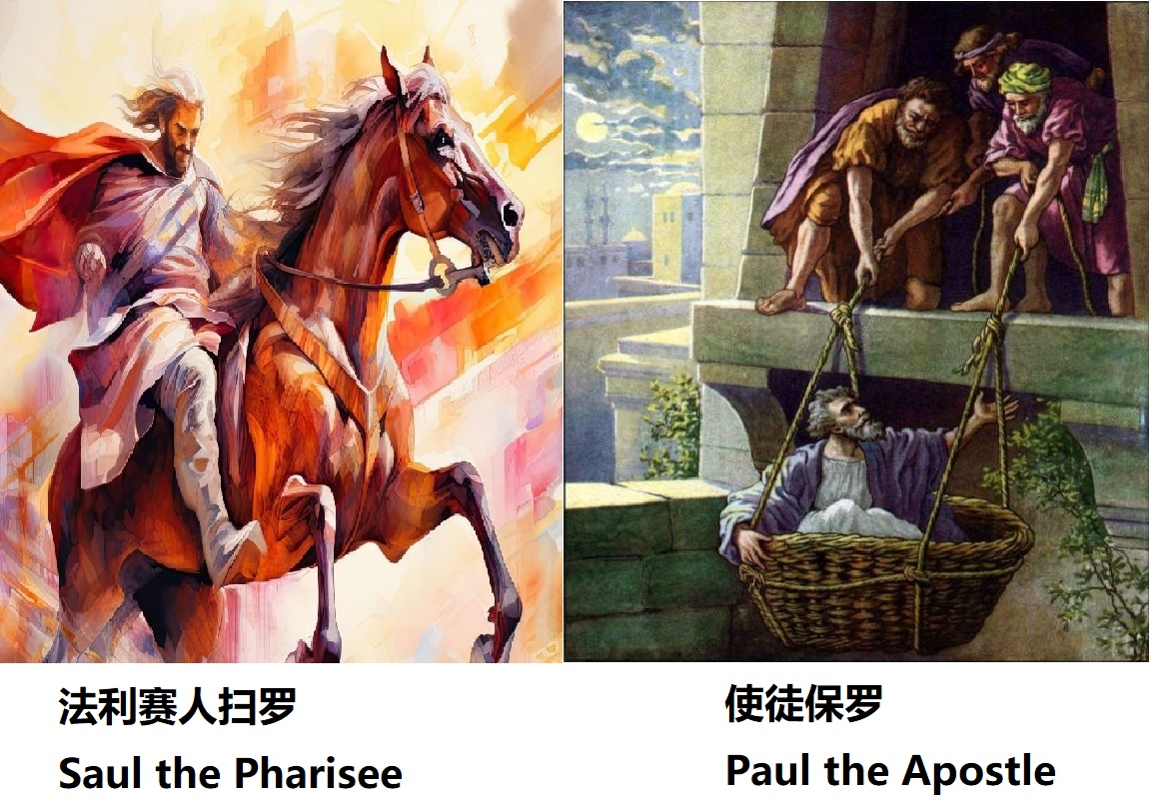

Slide 7
【哥林多后书 2 Corinthians 11:30-33】
30 我若必须自夸，就夸那关乎我软弱的事便了。
If I must boast, I will boast in the things which concern my infirmity.
31 那永远可称颂之主耶稣的父 神知道我不说谎。
The God and Father of our Lord Jesus Christ, who is blessed forever, knows that I am not lying.

Slide 8
【哥林多后书 2 Corinthians 11:30-33】
32 在大马士革亚哩达王手下的提督，把守大马士革城要捉拿我，
In Damascus the governor, under Aretas the king, was guarding the city of the Damascenes with a garrison, desiring to arrest me;
33 我就从窗户中，在筐子里从城墙上被人缒下去，脱离了他的手。
but I was let down in a basket through a window in the wall, and escaped from his hands.

Slide 9
【哥林多后书 2 Corinthians 12:9-10】
9 祂对我说：“我的恩典够你用的，因为我的能力是在人的软弱上显得完全。”所以，我更喜欢夸自己的软弱，好叫基督的能力覆庇我。
And He said to me, “My grace is sufficient for you, for My strength is made perfect in weakness.” Therefore most gladly I will rather boast in my infirmities, that the power of Christ may rest upon me.
10 我为基督的缘故，就以软弱、凌辱、急难、逼迫、困苦为可喜乐的，因我什么时候软弱，什么时候就刚强了。Therefore I take pleasure in infirmities, in reproaches, in needs, in persecutions, in distresses, for Christ’s sake. For when I am weak, then I am strong.

Slide 10
【哥林多前书 1 Corinthians 15:9-10a】
9 我原是使徒中最小的，不配称为使徒，因为我从前逼迫 神的教会。
For I am the least of the apostles, who am not worthy to be called an apostle, because I persecuted the church of God.
10a 然而我今日成了何等人，是蒙 神的恩才成的……
But by the grace of God I am what I am….

Slide 11
【腓立比书 Philippians 3:5-8】
5 我第八天受割礼，我是以色列族、便雅悯支派的人，是希伯来人所生的希伯来人。就律法说，我是法利赛人；
circumcised the eighth day, of the stock of Israel, of the tribe of Benjamin, a Hebrew of the Hebrews; concerning the law, a Pharisee;
6 就热心说，我是逼迫教会的；就律法上的义说，我是无可指摘的。
concerning zeal, persecuting the church; concerning the righteousness which is in the law, blameless.

Slide 12
【腓立比书 Philippians 3:5-8】
7 只是我先前以为与我有益的，我现在因基督都当作有损的。
But what things were gain to me, these I have counted loss for Christ.
8 不但如此，我也将万事当作有损的，因我以认识我主基督耶稣为至宝。我为祂已经丢弃万事，看作粪土，为要得着基督，
Yet indeed I also count all things loss for the excellence of the knowledge of Christ Jesus my Lord, for whom I have suffered the loss of all things, and count them as rubbish, that I may gain Christ

Slide 13
【哥林多前书 1 Corinthians 15:10a】
然而我今日成了何等人，是蒙 神的恩才成的……
But by the grace of God I am what I am….

Slide 14
【路加福音 Luke 12:16-21】
16 就用比喻对他们说：“有一个财主，田产丰盛，
Then He spoke a parable to them, saying: “The ground of a certain rich man yielded plentifully.
17 自己心里思想说：‘我的出产没有地方收藏，怎么办呢？’And he thought within himself, saying, ‘What shall I do, since I have no room to store my crops?’
18 又说：‘我要这么办：要把我的仓房拆了，另盖更大的，在那里好收藏我一切的粮食和财物，
So he said, ‘I will do this: I will pull down my barns and build greater, and there I will store all my crops and my goods.

Slide 15
【路加福音 Luke 12:16-21】
19 然后要对我的灵魂说：灵魂哪，你有许多财物积存，可作多年的费用，只管安安逸逸地吃喝快乐吧！’
And I will say to my soul, “Soul, you have many goods laid up for many years; take your ease; eat, drink, and be merry.”’
20 神却对他说：‘无知的人哪，今夜必要你的灵魂，你所预备的要归谁呢？’But God said to him, ‘Fool! This night your soul will be required of you; then whose will those things be which you have provided?’
21 凡为自己积财，在 神面前却不富足的，也是这样。”“So is he who lays up treasure for himself, and is not rich toward God.”

Slide 16
【传道书 Ecclesiastes 2:8-11，17】
8 我又为自己积蓄金银和君王的财宝，并各省的财宝；又得唱歌的男女和世人所喜爱的物，并许多的妃嫔。
I also gathered for myself silver and gold and the special treasures of kings and of the provinces. I acquired male and female singers, the delights of the sons of men, and musical instruments of all kinds.
9 这样，我就日见昌盛，胜过以前在耶路撒冷的众人。我的智慧仍然存留。
So I became great and excelled more than all who were before me in Jerusalem. Also my wisdom remained with me.

Slide 17
【传道书 Ecclesiastes 2:8-11，17】
10 凡我眼所求的，我没有留下不给他的；我心所乐的，我没有禁止不享受的；因我的心为我一切所劳碌的快乐，这就是我从劳碌中所得的份。Whatever my eyes desired I did not keep from them. I did not withhold my heart from any pleasure, For my heart rejoiced in all my labor; And this was my reward from all my labor.
11 后来，我察看我手所经营的一切事和我劳碌所成的功，谁知都是虚空，都是捕风，在日光之下毫无益处。
Then I looked on all the works that my hands had done And on the labor in which I had toiled; And indeed all was vanity and grasping for the wind. There was no profit under the sun.

Slide 18
【传道书 Ecclesiastes 2:8-11，17】
17 我所以恨恶生命，因为在日光之下所行的事，我都以为烦恼，都是虚空，都是捕风。
Therefore I hated life because the work that was done under the sun was distressing to me, for all is vanity and grasping for the wind.

Slide 19
【哥林多前书 1 Corinthians 15:9-10a】
9 我原是使徒中最小的，不配称为使徒，因为我从前逼迫 神的教会。
For I am the least of the apostles, who am not worthy to be called an apostle, because I persecuted the church of God.
10a 然而我今日成了何等人，是蒙 神的恩才成的……
But by the grace of God I am what I am….

Slide 20
【以赛亚书 Isaiah 64:6】
我们都像不洁净的人，所有的义都像污秽的衣服；我们都像叶子渐渐枯干，我们的罪孽好像风把我们吹去，
But we are all like an unclean thing, And all our righteousnesses are like filthy rags; We all fade as a leaf, And our iniquities, like the wind, Have taken us away.

Slide 21
【罗马书 Romans 5:8-11】
8 惟有基督在我们还作罪人的时候为我们死， 神的爱就在此向我们显明了。
But God demonstrates His own love toward us, in that while we were still sinners, Christ died for us.
9 现在我们既靠着祂的血称义，就更要藉着祂免去 神的忿怒。
Much more then, having now been justified by His blood, we shall be saved from wrath through Him.

Slide 22
【罗马书 Romans 5:8-11】
10 因为我们作仇敌的时候，且藉着 神儿子的死，得与 神和好；既已和好，就更要因祂的生得救了。
For if when we were enemies we were reconciled to God through the death of His Son, much more, having been reconciled, we shall be saved by His life.
11 不但如此，我们既藉着我主耶稣基督得与 神和好，也就藉着祂以 神为乐。
And not only that, but we also rejoice in God through our Lord Jesus Christ, through whom we have now received the reconciliation.

Slide 23
【哥林多前书 1 Corinthians 15:10】
然而我今日成了何等人，是蒙 神的恩才成的；并且祂所赐我的恩不是徒然的。我比众使徒格外劳苦，这原不是我，乃是 神的恩与我同在。
But by the grace of God I am what I am, and His grace toward me was not in vain; but I labored more abundantly than they all, yet not I, but the grace of God which was with me.

Slide 24
【使徒行传 Acts 9:13-16】
13 亚拿尼亚回答说：“主啊，我听见许多人说，这人怎样在耶路撒冷多多苦害你的圣徒，
Then Ananias answered, “Lord, I have heard from many about this man, how much harm he has done to Your saints in Jerusalem.
14 并且他在这里有从祭司长得来的权柄，捆绑一切求告你名的人。”
And here he has authority from the chief priests to bind all who call on Your name.”

Slide 25
【使徒行传 Acts 9:13-16】
15 主对亚拿尼亚说：“你只管去。他是我所拣选的器皿，要在外邦人和君王并以色列人面前宣扬我的名。
But the Lord said to him, “Go, for he is a chosen vessel of Mine to bear My name before Gentiles, kings, and the children of Israel.
16 我也要指示他，为我的名必须受许多的苦难。”
For I will show him how many things he must suffer for My name’s sake.”

Slide 26
【哥林多后书 2 Corinthians 11:23-33】
23 他们是基督的仆人吗？（我说句狂话），我更是。我比他们多受劳苦，多下监牢，受鞭打是过重的，冒死是屡次有的。
Are they ministers of Christ?—I speak as a fool—I am more: in labors more abundant, in stripes above measure, in prisons more frequently, in deaths often.
24 被犹太人鞭打五次，每次四十，减去一下；
From the Jews five times I received forty stripes minus one.

Slide 27
【哥林多后书 2 Corinthians 11:23-33】
25 被棍打了三次，被石头打了一次，遇着船坏三次，一昼一夜在深海里。
Three times I was beaten with rods; once I was stoned; three times I was shipwrecked; a night and a day I have been in the deep;
26 又屡次行远路，遭江河的危险、盗贼的危险、同族的危险、外邦人的危险、城里的危险、旷野的危险、海中的危险、假弟兄的危险。
in journeys often, in perils of waters, in perils of robbers, in perils of my own countrymen, in perils of the Gentiles, in perils in the city, in perils in the wilderness, in perils in the sea, in perils among false brethren;

Slide 28
【哥林多后书 2 Corinthians 11:23-33】
27 受劳碌、受困苦，多次不得睡，又饥又渴；多次不得食，受寒冷，赤身露体。
in weariness and toil, in sleeplessness often, in hunger and thirst, in fastings often, in cold and nakedness—
28 除了这外面的事，还有为众教会挂心的事，天天压在我身上。
besides the other things, what comes upon me daily: my deep concern for all the churches.
29 有谁软弱我不软弱呢？有谁跌倒我不焦急呢？
Who is weak, and I am not weak? Who is made to stumble, and I do not burn with indignation?

Slide 29
【哥林多后书 2 Corinthians 11:23-33】
30 我若必须自夸，就夸那关乎我软弱的事便了。
If I must boast, I will boast in the things which concern my infirmity.
31 那永远可称颂之主耶稣的父 神知道我不说谎。
The God and Father of our Lord Jesus Christ, who is blessed forever, knows that I am not lying.

Slide 30
【哥林多后书 2 Corinthians 11:23-33】
32 在大马士革亚哩达王手下的提督，把守大马士革城要捉拿我，
In Damascus the governor, under Aretas the king, was guarding the city of the Damascenes with a garrison, desiring to arrest me;
33 我就从窗户中，在筐子里从城墙上被人缒下去，脱离了他的手。
but I was let down in a basket through a window in the wall, and escaped from his hands.

Slide 31
【使徒行传 Acts 22:3】
保罗说：“我原是犹太人，生在基利家的大数，长在这城里，在迦玛列门下，按着我们祖宗严紧的律法受教，热心侍奉 神，像你们众人今日一样。
“I am indeed a Jew, born in Tarsus of Cilicia, but brought up in this city at the feet of Gamaliel, taught according to the strictness of our fathers’ law, and was zealous toward God as you all are today.

Slide 32
【腓立比书 Philippians 3:5-6】
5 我第八天受割礼，我是以色列族、便雅悯支派的人，是希伯来人所生的希伯来人。就律法说，我是法利赛人；
circumcised the eighth day, of the stock of Israel, of the tribe of Benjamin, a Hebrew of the Hebrews; concerning the law, a Pharisee;
6 就热心说，我是逼迫教会的；就律法上的义说，我是无可指摘的。
concerning zeal, persecuting the church; concerning the righteousness which is in the law, blameless.

Slide 33
【哥林多前书 1 Corinthians 15:10a】
然而我今日成了何等人，是蒙 神的恩才成的……
But by the grace of God I am what I am….

Slide 34
【提摩太后书 2 Timothy 4:6-8】
6 我现在被浇奠，我离世的时候到了。
For I am already being poured out as a drink offering, and the time of my departure is at hand.
7 那美好的仗我已经打过了，当跑的路我已经跑尽了，所信的道我已经守住了。
I have fought the good fight, I have finished the race, I have kept the faith.

Slide 35
【提摩太后书 2 Timothy 4:6-8】
8 从此以后，有公义的冠冕为我存留，就是按着公义审判的主到了那日要赐给我的，不但赐给我，也赐给凡爱慕祂显现的人。
Finally, there is laid up for me the crown of righteousness, which the Lord, the righteous Judge, will give to me on that Day, and not to me only but also to all who have loved His appearing.

