Slide 1

主日信息

Slide 2
他的慈愛永遠長存
His love endures forever (NIV)
His mercy endures forever (NKJV)

Slide 3
歷代志上 1 Chronicles 16:34
³⁴ 應當稱謝耶和華；因他本為善，他的慈愛永遠長存！
³⁴ O give thanks unto the Lord; for he is good; for his mercy endures for ever.

Slide 4
以弗所書 Ephesians 2:4-5
⁴ 然而，神既有豐富的憐憫，因他愛我們的大愛，⁵ 當我們死在過犯中的時候，便叫我們與基督一同活過來。你們得救是本乎恩。
⁴ But God, who is rich in mercy, because of His great love with which He loved us, ⁵ even when we were dead in trespasses, made us alive together with Christ (by grace you have been saved),

Slide 5
提多書 Titus 3:5
⁵ 他便救了我們；並不是因我們自己所行的義，乃是照他的憐憫，藉著重生的洗和聖靈的更新。
⁵ not by works of righteousness which we have done, but according to His mercy He saved us, through the washing of regeneration and renewing of the Holy Spirit,

Slide 6
詩篇 Psalm 136
^{1你們要稱謝耶和華，因他本為善；他的慈愛永遠長存。}
^{2你們要稱謝萬神之神，因他的慈愛永遠長存。}
^{3你們要稱謝萬主之主，因他的慈愛永遠長存。}
1 Oh, give thanks to the Lord, for He is good!
^{For His mercy endures forever.}
2 Oh, give thanks to the God of gods!
^{For His mercy endures forever.}
3 Oh, give thanks to the Lord of lords!
^{For His mercy endures forever:}

Slide 7
詩篇 Psalm 136
^{4稱謝那獨行大奇事的，因他的慈愛永遠長存。}
^{5稱謝那用智慧造天的，因他的慈愛永遠長存。}
^{6稱謝那鋪地在水以上的，因他的慈愛永遠長存。}
4 To Him who alone does great wonders,
^{For His mercy endures forever;}
5 To Him who by wisdom made the heavens,
^{For His mercy endures forever;}
6 To Him who laid out the earth above the waters,
^{For His mercy endures forever;}

Slide 8
詩篇 Psalm 136
^{7稱謝那造成大光的，因他的慈愛永遠長存。}
^{8他造日頭管白晝，因他的慈愛永遠長存。}
^{9他造月亮星宿管黑夜，因他的慈愛永遠長存。}
7 To Him who made great lights,
^{For His mercy endures forever—}
^{8 The sun to rule by day,}
^{For His mercy endures forever;}
9 The moon and stars to rule by night,
^{For His mercy endures forever.}

Slide 9
詩篇 Psalm 136
^{10稱謝那擊殺埃及人之長子的，因他的慈愛永遠長存。}
^{11他領以色列人從他們中間出來，因他的慈愛永遠長存。}
^{12他施展大能的手和伸出來的膀臂，因他的慈愛永遠長存。}
10 To Him who struck Egypt in their firstborn,
^{For His mercy endures forever;}
11 And brought out Israel from among them,
^{For His mercy endures forever;}
12 With a strong hand, and with [a]an outstretched arm,
^{For His mercy endures forever;}

Slide 10
詩篇 Psalm 136
^{13稱謝那分裂紅海的，因他的慈愛永遠長存。}
^{14他領以色列從其中經過，因他的慈愛永遠長存；}
^{15卻把法老和他的軍兵推翻在紅海裡，因他的慈愛永遠長存。}
13 To Him who divided the Red Sea in two,
^{For His mercy endures forever;}
14 And made Israel pass through the midst of it,
^{For His mercy endures forever;}
15 But overthrew Pharaoh and his army in the Red Sea,
^{For His mercy endures forever;}

Slide 11
詩篇 Psalm 136
^{16稱謝那引導自己的民行走曠野的，因他的慈愛永遠長存。}
^{17稱謝那擊殺大君王的，因他的慈愛永遠長存。}
^{18他殺戮有名的君王，因他的慈愛永遠長存；}
16 To Him who led His people through the wilderness,
^{For His mercy endures forever;}
17 To Him who struck down great kings,
^{For His mercy endures forever;}
^{18 And slew famous kings,}
^{For His mercy endures forever—}

Slide 12
詩篇 Psalm 136
^{19就是殺戮亞摩利王西宏，因他的慈愛永遠長存；}
^{20又殺巴珊王噩，因他的慈愛永遠長存。}
^{21他將他們的地賜他的百姓為業，因他的慈愛永遠長存；}
^{19 Sihon king of the Amorites,}
^{For His mercy endures forever;}
^{20 And Og king of Bashan,}
^{For His mercy endures forever—}
21 And gave their land as a [b]heritage,
^{For His mercy endures forever;}

Slide 13
詩篇 Psalm 136
^{22就是賜他的僕人以色列為業，因他的慈愛永遠長存。}
^{23他顧念我們在卑微的地步，因他的慈愛永遠長存。}
^{24他救拔我們脫離敵人，因他的慈愛永遠長存。}
22 A heritage to Israel His servant,
^{For His mercy endures forever.}
23 Who remembered us in our lowly state,
^{For His mercy endures forever;}
24 And rescued us from our enemies,
^{For His mercy endures forever;}

Slide 14
詩篇 Psalm 136
^{25他賜糧食給凡有血氣的，因他的慈愛永遠長存。}
^{26你們要稱謝天上的神，因他的慈愛永遠長存。}
25 Who gives food to all flesh,
^{For His mercy endures forever.}
26 Oh, give thanks to the God of heaven!
^{For His mercy endures forever.}

Slide 15
哈利路亞詩篇(Hallel)
指的是《詩篇》中的特定詩篇組合，這些詩篇在猶太教禮拜中使用。主要有兩組哈利路亞詩篇：
埃及的哈利路亞 The Egyptian Hallel（詩篇113-118）： 這些詩篇在猶太節日如逾越節、七七節、住棚節..時誦讀。
大哈利路亞 The Great Hallel（詩篇136）： 這首詩篇因其反復的副歌“因他的慈愛永遠長存”而著名，在節慶場合如逾越節晚餐時誦讀。
因此，在猶太傳統中，一共有7首詩篇被特定指定為“哈利路亞詩篇”：詩篇113到118，以及詩篇136。

Slide 16
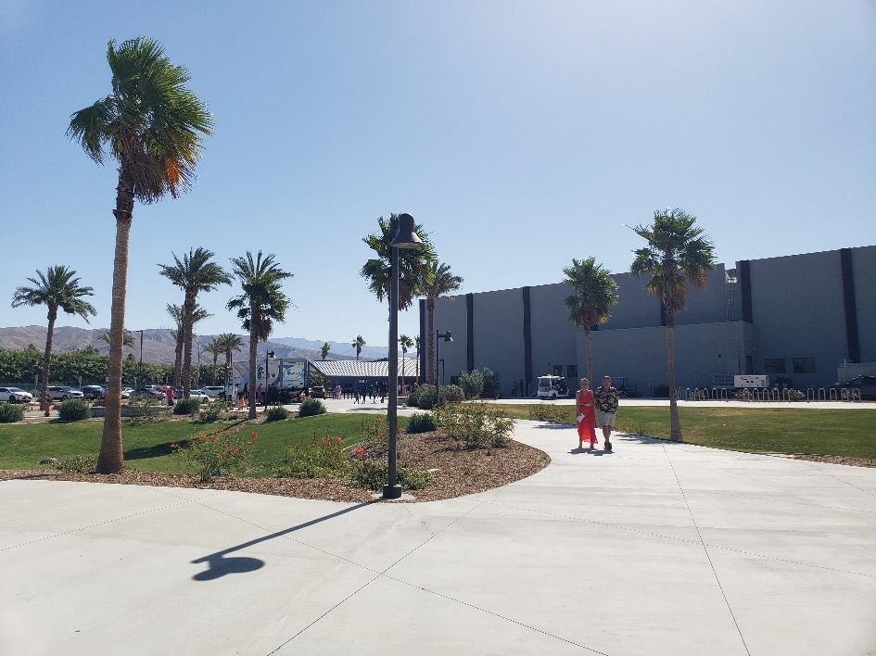
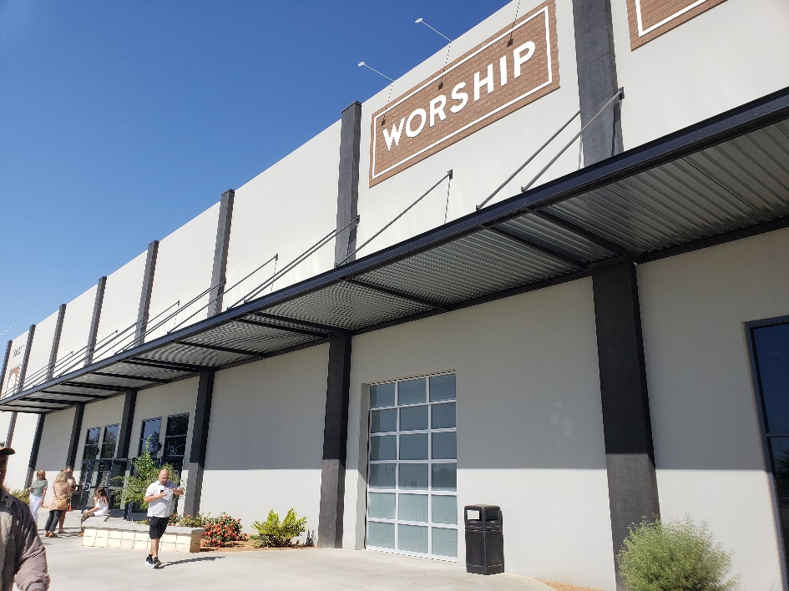
^{Defeated by AI???}

Slide 17
詩篇 Psalm 136:1-3
認識神的主權 (Sovereignty)
  耶和華 (YHWH) - "LORD "
  出埃及記 Exodus 34:6-7
  萬神之神 (Elohim) - "God of gods"
  詩篇 Psalm 95:3
  萬主之主 (Adonai) - "Lord of lords"
  啟示錄 Revelation 17:14
神不變的憐憫和慈愛 (Mercy & Love)
耶利米哀歌 Lamentations 3:22-23

Slide 18
詩篇 Psalm 136:1-3
認識神的主權 (Sovereignty)
  耶和華 (YHWH) - "LORD "
  出埃及記 Exodus 34:6-7
⁶ 耶和華在他面前宣告說：耶和華，耶和華，是有憐憫有恩典的神，不輕易發怒，並有豐盛的慈愛和誠實，⁷ 為千萬人存留慈愛，赦免罪孽、過犯，和罪惡，萬不以有罪的為無罪，必追討他的罪，自父及子，直到三、四代。
⁶ And the Lord passed before him and proclaimed, “The Lord, the Lord God, merciful and gracious, longsuffering, and abounding in goodness and truth, ⁷ keeping mercy for thousands, forgiving iniquity and transgression and sin, by no means clearing the guilty, visiting the iniquity of the fathers upon the children and the children’s children to the third and the fourth generation.”

Slide 19
詩篇 Psalm 136:1-3
認識神的主權 (Sovereignty)
  萬神之神 (Elohim) - "God of gods"
  詩篇 Psalm 95:3
³ 因耶和華為大神，為大王，超乎萬神之上。
³ For the Lord is the great God,
And the great King above all gods.

Slide 20
詩篇 Psalm 136:1-3
認識神的主權 (Sovereignty)
  萬主之主 (Adonai) - "Lord of lords"
  啟示錄 Revelation 17:14
¹⁴ 他們與羔羊爭戰，羔羊必勝過他們，因為羔羊是萬主之主、萬王之王。同著羔羊的，就是蒙召、被選、有忠心的，也必得勝。
¹⁴ These will make war with the Lamb, and the Lamb will overcome them, for He is Lord of lords and King of kings; and those who are with Him are called, chosen, and faithful.”

Slide 21
詩篇 Psalm 136:1-3
神不變的憐憫和慈愛 (Mercy & Love)
耶利米哀歌 Lamentations 3:22-23
²² 我們不致消滅，是出於耶和華諸般的慈愛；是因他的憐憫不致斷絕。²³ 每早晨，這都是新的；你的誠實極其廣大！
²² Through the Lord’s mercies we are not consumed,
Because His compassions fail not.²³ They are new every morning;

Slide 22
詩篇 Psalm 136
C.H.司布真： “我們知道詩篇136中的重複句‘他的慈愛永遠長存’是由人民所唱，而且整篇詩篇在聖殿崇拜中被吟唱。讓我們因他的能力的偉大，他智慧的深奧，和他恩典的豐富而崇拜主，並讓我們的崇拜充滿感恩。”
C. H. Spurgeon: "We know that the refrain 'His love endures forever' was sung by the people, and that the whole Psalm was chanted in the temple worship. Let us adore the Lord for the greatness of his power, the depth of his wisdom, and the exceeding riches of his grace, and let our adoration be sweetened with gratitude."

Slide 23
詩篇 Psalm 136
約翰·加爾文：“這篇詩篇以‘他的慈愛永遠長存’的短語反覆強調，提醒我們在上帝的所有作為中，他的慈愛總是存在，並且永不失敗。這是對上帝恆久善良的鼓勵。”
John Calvin: "This Psalm is notable for its reiteration of the phrase 'His love endures forever,' which reminds us that in all the works of God, His mercy is always present and never fails. It is an encouragement to trust in God's perpetual goodness."

Slide 24
詩篇 Psalm 136
A.W.陶恕：“詩篇136中的重複句並非多餘，而是一個強有力的提醒，提醒我們上帝不變的愛。它旨在將他的慈愛的恆久性深印在我們心中，無論在任何情況下。”
A. W. Tozer: "The repeated refrain in Psalm 136 is not redundant but rather a powerful reminder of God's unfailing love. It serves to imprint upon our hearts the enduring nature of His mercy through every circumstance."

Slide 25
詩篇 Psalm 136
查爾斯·衛斯理：“詩篇136中‘他的慈愛永遠長存’的重複是一首神聖信實的讚美詩。它捕捉了上帝永恆慈愛的精髓，並呼喚我們持續不斷地感恩。”
Charles Wesley: "The repetition of 'His love endures forever' in Psalm 136 is a hymn of divine faithfulness. It captures the essence of God’s everlasting mercy and calls us to a continual song of gratitude."

Slide 26
詩篇 Psalm 136
提摩太·凱勒：“詩篇136是一首宏偉的感恩交響曲。每一節和其重複句提醒我們，上帝的愛編織在我們存在的每一個角落，這一真理應該激勵我們不斷地讚美。”
Timothy Keller: "Psalm 136 is a magnificent symphony of gratitude. Each verse and its refrain remind us that God's love is woven into the very fabric of our existence, a truth that should move us to constant praise."

Slide 27
詩篇 Psalm 136
R.C.史普羅： “這篇詩篇提醒我們，上帝的愛不是善變或短暫的，而是像他一樣永恆的。‘他的慈愛永遠長存’的重複性質旨在將這個真理刻在我們心中。”
R.C. Sproul: "Psalm 136 is a poetic masterpiece that reminds us of the perpetual nature of God's love. Each verse's conclusion with 'His love endures forever' underscores the steadfastness of His mercy."

Slide 28
詩篇 Psalm 136:4-9
神的創造能力和智慧 (Power & Wisdom)
獨行大奇事(does great wonders)
希伯來Hebrews 13:8
出埃及記 Exodus 15:11, 詩篇 Psalm 77:14,
耶利米書 Jeremiah 32:20
神的供應和護理 (Provision and Sustenance)
耶利米書 Jeremiah 31:35

Slide 29
詩篇 Psalm 136:4-9
神的創造能力和智慧 (Power & Wisdom)
獨行大奇事(does great wonders)
希伯來Hebrews 13:8
⁸ 耶穌基督，昨日、今日、一直到永遠、是一樣的。
⁸ Jesus Christ is the same yesterday, today, and forever.

Slide 30
詩篇 Psalm 136:4-9
神的創造能力和智慧 (Power & Wisdom)
出埃及記 Exodus 15:11
¹¹ 耶和華阿，眾神之中，誰能像你？誰能像你─至聖至榮，可頌可畏，施行奇事？
¹¹ “Who is like You, O Lord, among the gods?
Who is like You, glorious in holiness,
Fearful in praises, doing wonders?

Slide 31
詩篇 Psalm 136:4-9
神的創造能力和智慧 (Power & Wisdom)
耶利米書 Jeremiah 32:20
²⁰ 在埃及地顯神蹟奇事，直到今日在以色列和別人中間也是如此，使自己得了名聲，正如今日一樣。
²⁰ You have set signs and wonders in the land of Egypt, to this day, and in Israel and among other men; and You have made Yourself a name, as it is this day.

Slide 32


Slide 33
詩篇 Psalm 136:4-9
神的供應和護理 (Provision and Sustenance)
耶利米書 Jeremiah 31:35
³⁵ 那使太陽白日發光，使星月有定例，黑夜發亮，又攪動大海，使海中波浪匉訇的，萬軍之耶和華是他的名。他如此說：
³⁵ Thus says the Lord,
Who gives the sun for a light by day,
The ordinances of the moon and the stars for a light by night,
Who disturbs the sea,
And its waves roar
(The Lord of hosts is His name):

Slide 34
詩篇 Psalm 136:10-22
神的救贖 I (Redemption I)
神的預備 出埃及記 Exodus 6:6
神的引領 出埃及記 Exodus 14:29-30, 15:4-5
神的保護 出埃及記 Exodus 13:21-22,
申命記 Deuteronomy 2:24-25
神的應許 約書亞記 Joshua 21:43-45

Slide 35
詩篇 Psalm 136:10-22
神的救贖 I (Redemption I)
神的預備 出埃及記 Exodus 6:6
⁶ 所以你要對以色列人說：我是耶和華；我要用伸出來的膀臂重重的刑罰埃及人，救贖你們脫離他們的重擔，不做他們的苦工。
⁶ Therefore say to the children of Israel: ‘I am the Lord; I will bring you out from under the burdens of the Egyptians, I will rescue you from their bondage, and I will redeem you with ^{[a]}an outstretched arm and with great judgments.

Slide 36
詩篇 Psalm 136:10-22
神的救贖 I (Redemption I)
神的引領 出埃及記 Exodus 14:29-30,
²⁹ 以色列人卻在海中走乾地；水在他們的左右作了牆垣。³⁰ 當日，耶和華這樣拯救以色列人脫離埃及人的手，以色列人看見埃及人的死屍都在海邊了
²⁹ But the children of Israel had walked on dry land in the midst of the sea, and the waters were a wall to them on their right hand and on their left. ³⁰ So the Lord saved Israel that day out of the hand of the Egyptians, and Israel saw the Egyptians dead on the seashore.

Slide 37
詩篇 Psalm 136:10-22
神的救贖 I (Redemption I)
神的保護 申命記 Deuteronomy 2:24-25
²⁴ 你們起來前往，過亞嫩谷；我已將亞摩利人希實本王西宏和他的地交在你手中，你要與他爭戰，得他的地為業。²⁵ 從今日起，我要使天下萬民聽見你的名聲都驚恐懼怕，且因你發顫傷慟。
²⁴ “ ‘Rise, take your journey, and cross over the River Arnon. Look, I have given into your hand Sihon the Amorite, king of Heshbon, and his land. Begin to possess it, and engage him in battle. ²⁵ This day I will begin to put the dread and fear of you upon the nations under the whole heaven, who shall hear the report of you, and shall tremble and be in anguish because of you.’

Slide 38
詩篇 Psalm 136:10-22
神的救贖 I (Redemption I)
神的應許 約書亞記 Joshua 21:43-45
⁴³ 這樣，耶和華將從前向他們列祖起誓所應許的全地賜給以色列人，他們就得了為業，住在其中。⁴⁴ 耶和華照著向他們列祖起誓所應許的一切話，使他們四境平安；他們一切仇敵中，沒有一人在他們面前站立得住。耶和華把一切仇敵都交在他們手中。⁴⁵ 耶和華應許賜福給以色列家的話一句也沒有落空，都應驗了。
⁴³ So the Lord gave to Israel all the land of which He had sworn to give to their fathers, and they took possession of it and dwelt in it. ⁴⁴ The Lord gave them rest all around, according to all that He had sworn to their fathers. And not a man of all their enemies stood against them; the Lord delivered all their enemies into their hand. ⁴⁵ Not a word failed of any good thing which the Lord had spoken to the house of Israel. All came to pass.

Slide 39
詩篇 Psalm 136:23-24
神的救贖 II (Redemption II)
  詩篇 Psalm 103:13-14
  馬太 Matthew 6:26

Slide 40
詩篇 Psalm 136:23-24
神的救贖 II (Redemption II)
  詩篇 Psalm 103:13-14
¹³ 父親怎樣憐恤他的兒女，耶和華也怎樣憐恤敬畏他的人！¹⁴因為他知道我們的本體，思念我們不過是塵土。
¹³ As a father pities his children, So the Lord pities those who fear Him. ¹⁴ For He knows our frame; He remembers that we are dust.

Slide 41
詩篇 Psalm 136:23-24
神的救贖 II (Redemption II)
  馬太 Matthew 6:26
²⁶ 你們看那天上的飛鳥，也不種，也不收，也不積蓄在倉裡，你們的天父尚且養活他。你們不比飛鳥貴重得多麼？
²⁶ Look at the birds of the air, for they neither sow nor reap nor gather into barns; yet your heavenly Father feeds them. Are you not of more value than they?

Slide 42
詩篇 Psalm 136:25-26
展望未來 (Look forward)
  供應全地 (gives)
  使徒行傳 Acts 14:17
以感謝回應 (Give thanks)
詩篇 Psalm 103:17, 帖前 1 Thessalonians 5:16-18

Slide 43
詩篇 Psalm 136:25-26
展望未來 (Look forward)
  供應全地 (gives)
  使徒行傳 Acts 14:17
¹⁷ 然而為自己未嘗不顯出證據來，就如常施恩惠，從天降雨，賞賜豐年，叫你們飲食飽足，滿心喜樂。
¹⁷ Nevertheless He did not leave Himself without witness, in that He did good, gave us rain from heaven and fruitful seasons, filling our hearts with food and gladness.

Slide 44
詩篇 Psalm 136:25-26
展望未來 (Look forward)
  供應全地 (gives)
  路加 Luke 12:24
²⁴ 你想烏鴉，也不種也不收，又沒有倉又沒有庫，神尚且養活他。你們比飛鳥是何等的貴重
²⁴ Consider the ravens, for they neither sow nor reap, which have neither storehouse nor barn; and God feeds them. Of how much more value are you than the birds?

Slide 45
詩篇 Psalm 136:25-26
以感謝回應 (Give thanks)
詩篇 Psalm 103:17
¹⁷ 但耶和華的慈愛歸於敬畏他的人，從亙古到永遠；他的公義也歸於子子孫孫
¹⁷ But the mercy of the Lord is from everlasting to everlasting
On those who fear Him, And His righteousness to children’s children,

Slide 46
詩篇 Psalm 136:25-26
以感謝回應 (Give thanks)
  帖前 1 Thessalonians 5:16-18
¹⁶ 要常常喜樂，¹⁷ 不住的禱告，¹⁸ 凡事謝恩；因為這是神在基督耶穌裡向你們所定的旨意。
¹⁶ Rejoice always, ¹⁷ pray without ceasing, ¹⁸ in everything give thanks; for this is the will of God in Christ Jesus for you.

