Slide 1
主耶稣为何赴死？
Why Jesus Came To Die？
Boise Chinese Christian Church
4/6/2025

Slide 2
【罗马书 Romans 1:3-4】
3 论到祂儿子我主耶稣基督，按肉体说，是从大卫后裔生的；
concerning His Son Jesus Christ our Lord, who was born of the seed of David according to the flesh,
4 按圣善的灵说，因从死里复活，以大能显明是 神的儿子。
and declared to be the Son of God with power according to the Spirit of holiness, by the resurrection from the dead.

Slide 3
【罗马书 Romans 3:25a】
神设立耶稣作挽回祭，是凭着耶稣的血，藉着人的信，要显明 神的义……
whom God set forth as a propitiation by His blood, through faith, to demonstrate His righteousness….

Slide 4
【路加福音 Luke 15:11-24】
11 耶稣又说：“一个人有两个儿子。
Then He said: "A certain man had two sons.
12 小儿子对父亲说：‘父亲，请你把我应得的家业分给我。’他父亲就把产业分给他们。
And the younger of them said to his father, "Father, give me the portion of goods that falls to me.' So he divided to them his livelihood.

Slide 5
【路加福音 Luke 15:11-24】
13 过了不多几日，小儿子就把他一切所有的都收拾起来，往远方去了。在那里任意放荡，浪费资财。
And not many days after, the younger son gathered all together, journeyed to a far country, and there wasted his possessions with prodigal living.
14 既耗尽了一切所有的，又遇着那地方大遭饥荒，就穷苦起来。
But when he had spent all, there arose a severe famine in that land, and he began to be in want.

Slide 6
【路加福音 Luke 15:11-24】
15 于是去投靠那地方的一个人，那人打发他到田里去放猪。
Then he went and joined himself to a citizen of that country, and he sent him into his fields to feed swine.
16 他恨不得拿猪所吃的豆荚充饥，也没有人给他。
And he would gladly have filled his stomach with the pods that the swine ate, and no one gave him anything.

Slide 7
【路加福音 Luke 15:11-24】
17 他醒悟过来，就说：‘我父亲有多少的雇工，口粮有余，我倒在这里饿死吗？
"But when he came to himself, he said, "How many of my father's hired servants have bread enough and to spare, and I perish with hunger!
18 我要起来，到我父亲那里去，向他说：父亲，我得罪了天，又得罪了你，
I will arise and go to my father, and will say to him, "Father, I have sinned against heaven and before you,

Slide 8
【路加福音 Luke 15:11-24】
19 从今以后，我不配称为你的儿子，把我当作一个雇工吧！’
and I am no longer worthy to be called your son. Make me like one of your hired servants."'
20 于是起来，往他父亲那里去。相离还远，他父亲看见，就动了慈心，跑去抱着他的颈项，连连与他亲嘴。"And he arose and came to his father. But when he was still a great way off, his father saw him and had compassion, and ran and fell on his neck and kissed him.

Slide 9
【路加福音 Luke 15:11-24】
21 儿子说：‘父亲，我得罪了天，又得罪了你，从今以后，我不配称为你的儿子。’
And the son said to him, "Father, I have sinned against heaven and in your sight, and am no longer worthy to be called your son.'
22 父亲却吩咐仆人说：‘把那上好的袍子快拿出来给他穿，把戒指戴在他指头上，把鞋穿在他脚上，"But the father said to his servants, "Bring out the best robe and put it on him, and put a ring on his hand and sandals on his feet.

Slide 10
【路加福音 Luke 15:11-24】
23 把那肥牛犊牵来宰了，我们可以吃喝快乐。
And bring the fatted calf here and kill it, and let us eat and be merry;
24 因为我这个儿子是死而复活，失而又得的。’他们就快乐起来。
for this my son was dead and is alive again; he was lost and is found.' And they began to be merry.

Slide 11
【约翰福音 John 8:3-11】
3 文士和法利赛人带着一个行淫时被拿的妇人来，叫她站在当中。
Then the scribes and Pharisees brought to Him a woman caught in adultery. And when they had set her in the midst,
4 就对耶稣说：“夫子，这妇人是正行淫之时被拿的。
they said to Him, “Teacher, this woman was caught in adultery, in the very act.

Slide 12
【约翰福音 John 8:3-11】
5 摩西在律法上吩咐我们，把这样的妇人用石头打死。你说该把她怎么样呢？”
Now Moses, in the law, commanded us that such should be stoned. But what do You say?”
6 他们说这话，乃试探耶稣，要得着告祂的把柄。耶稣却弯着腰用指头在地上画字。
This they said, testing Him, that they might have something of which to accuse Him. But Jesus stooped down and wrote on the ground with His finger, as though He did not hear.

Slide 13
【约翰福音 John 8:3-11】
7 他们还是不住地问祂，耶稣就直起腰来，对他们说：“你们中间谁是没有罪的，谁就可以先拿石头打她。”
So when they continued asking Him, He raised Himself up and said to them, “He who is without sin among you, let him throw a stone at her first.”
8 于是又弯着腰用指头在地上画字。
And again He stooped down and wrote on the ground.

Slide 14
【约翰福音 John 8:3-11】
9 他们听见这话，就从老到少一个一个地都出去了，只剩下耶稣一人，还有那妇人仍然站在当中。Then those who heard it, being convicted by their conscience, went out one by one, beginning with the oldest even to the last. And Jesus was left alone, and the woman standing in the midst.
10 耶稣就直起腰来，对她说：“妇人，那些人在哪里呢？没有人定你的罪吗？” When Jesus had raised Himself up and saw no one but the woman, He said to her, “Woman, where are those accusers of yours? Has no one condemned you?”

Slide 15
【约翰福音 John 8:3-11】
11 她说：“主啊，没有。”耶稣说：“我也不定你的罪，去吧！从此不要再犯罪了。”
She said, “No one, Lord.” And Jesus said to her, “Neither do I condemn you; go and sin no more.”

Slide 16
【路加福音 Luke 23:39-43】
39 那同钉的两个犯人，有一个讥诮祂说：“你不是基督吗？可以救自己和我们吧！”
Then one of the criminals who were hanged blasphemed Him, saying, “If You are the Christ, save Yourself and us.”
40 那一个就应声责备他说：“你既是一样受刑的，还不怕 神吗？
But the other, answering, rebuked him, saying, “Do you not even fear God, seeing you are under the same condemnation?

Slide 17
【路加福音 Luke 23:39-43】
41 我们是应该的，因我们所受的与我们所作的相称，但这个人没有作过一件不好的事。” And we indeed justly, for we receive the due reward of our deeds; but this Man has done nothing wrong.”
42 就说：“耶稣啊，你得国降临的时候，求你记念我！” Then he said to Jesus, “Lord, remember me when You come into Your kingdom.”
43 耶稣对他说：“我实在告诉你：今日你要同我在乐园里了。”And Jesus said to him, “Assuredly, I say to you, today you will be with Me in Paradise.”

Slide 18
【罗马书 Romans 3:25a】
神设立耶稣作挽回祭，是凭着耶稣的血，藉着人的信，要显明 神的义……
whom God set forth as a propitiation by His blood, through faith, to demonstrate His righteousness….

Slide 19
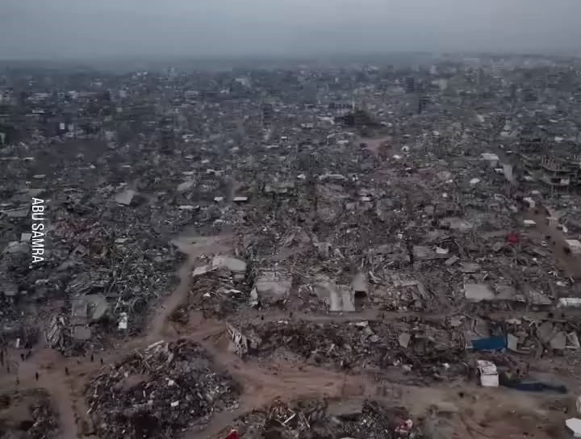

Slide 20
【耶利米书 Jeremiah 17:9】
“人心比万物都诡诈，坏到极处，谁能识透呢? ”
The heart is deceitful above all things and beyond cure. Who can understand it?

Slide 21
【约翰一书 1 John 3:16a】
主为我们舍命，我们从此就知道何为爱……
By this we know love, because He laid down His life for us. And we also ought to lay down our lives for the brethren.

Slide 22
【罗马书 Romans 5:6-8】
6 因我们还软弱的时候，基督就按所定的日期为罪人死。For when we were still without strength, in due time Christ died for the ungodly.
7 为义人死，是少有的；为仁人死，或者有敢作的。For scarcely for a righteous man will one die; yet perhaps for a good man someone would even dare to die.
8 惟有基督在我们还作罪人的时候为我们死， 神的爱就在此向我们显明了。
But God demonstrates His own love toward us, in that while we were still sinners, Christ died for us.

Slide 23
【以赛亚书 Isaiah 53:5】
哪知祂为我们的过犯受害，为我们的罪孽压伤。因祂受的刑罚，我们得平安；因祂受的鞭伤，我们得医治。
But He was wounded for our transgressions, He was bruised for our iniquities; The chastisement for our peace was upon Him, And by His stripes we are healed.

Slide 24
【罗马书 Romans 8:32-39】
32 神既不爱惜自己的儿子为我们众人舍了，岂不也把万物和祂一同白白地赐给我们吗？
He who did not spare His own Son, but delivered Him up for us all, how shall He not with Him also freely give us all things?
33 谁能控告 神所拣选的人呢？有 神称他们为义了。（或作“是称他们为义的 神吗？”）
Who shall bring a charge against God’s elect? It is God who justifies.

Slide 25
【罗马书 Romans 8:32-39】
34 谁能定他们的罪呢？有基督耶稣已经死了，而且从死里复活，现今在 神的右边，也替我们祈求。（“有基督云云”，或作“是已经死了，而且从死里复活，现今在 神的右边，也替我们祈求的基督耶稣吗？”）Who is he who condemns? It is Christ who died, and furthermore is also risen, who is even at the right hand of God, who also makes intercession for us.
35 谁能使我们与基督的爱隔绝呢？难道是患难吗？是困苦吗？是逼迫吗？是饥饿吗？是赤身露体吗？是危险吗？是刀剑吗？Who shall separate us from the love of Christ? Shall tribulation, or distress, or persecution, or famine, or nakedness, or peril, or sword?

Slide 26
【罗马书 Romans 8:32-39】
36 如经上所记：“我们为你的缘故终日被杀，人看我们如将宰的羊。”
As it is written: “For Your sake we are killed all day long; We are accounted as sheep for the slaughter.”
37 然而，靠着爱我们的主，在这一切的事上已经得胜有余了。
Yet in all these things we are more than conquerors through Him who loved us.

Slide 27
【罗马书 Romans 8:32-39】
38 因为我深信无论是死，是生，是天使，是掌权的，是有能的，是现在的事，是将来的事，
For I am persuaded that neither death nor life, nor angels nor principalities nor powers, nor things present nor things to come,
39 是高处的，是低处的，是别的受造之物，都不能叫我们与 神的爱隔绝；这爱是在我们的主基督耶稣里的。
nor height nor depth, nor any other created thing, shall be able to separate us from the love of God which is in Christ Jesus our Lord.

